Slide 1
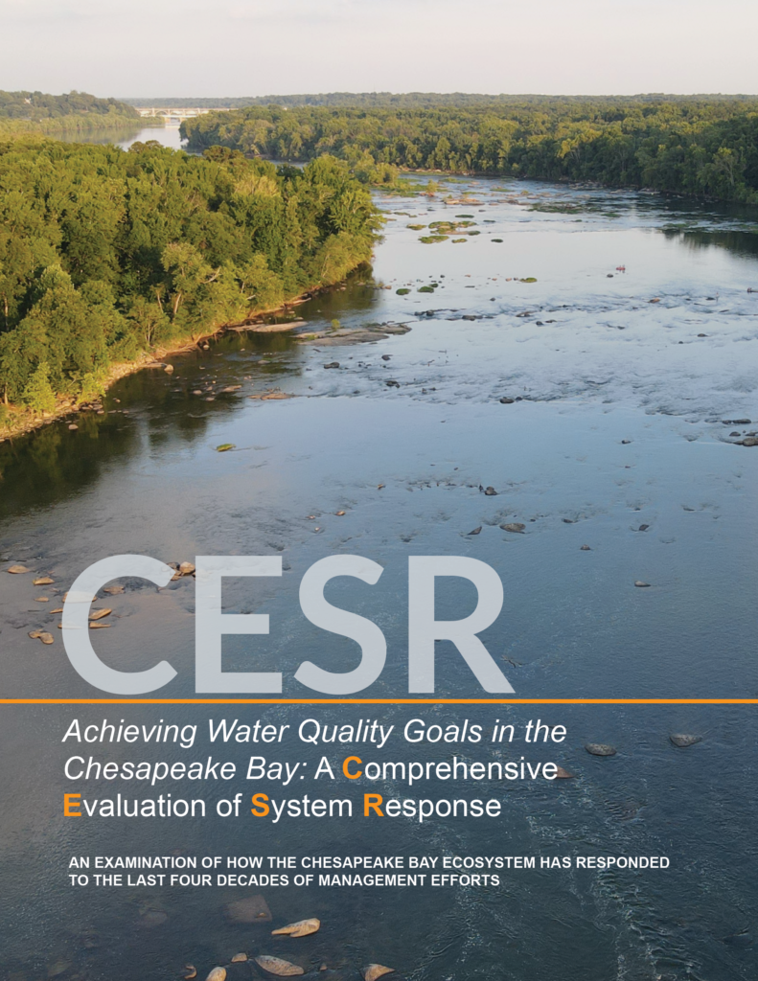
Why HB 1165, the Whole Watershed Act
“The May 2023 report, A Comprehensive Evaluation of System Response (CESR), summarizes the Scientific and Technical Advisory Committee (STAC) evaluation of why progress toward meeting the TMDL and water quality standards has been slower than expected and offers options for how progress can be accelerated. CESR is a summation of a three year investigation into the 40 year effort to reduce nutrient loads to Chesapeake Bay.”
Chesapeake Bay Scientific and Technical Advisory Committee (STAC)
Source: Chesapeake Bay Scientific and Technical Advisory Committee

Slide 2
Source: Chesapeake Bay Scientific and Technical Advisory Committee

Slide 3
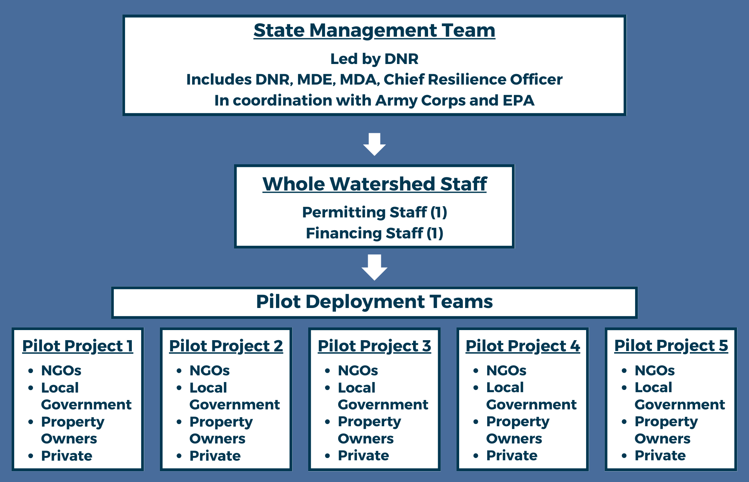
Streamlining the process

Slide 4
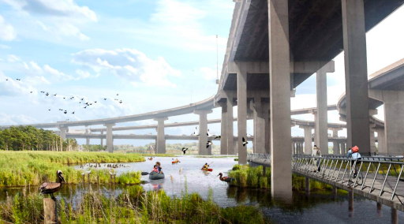
Investing in diverse communities all across our state
Of the five watersheds:
One urban
One suburban
One agricultural
One project along a state border
Two within overburdened communities
Photo credit: Reimagine Middle Branch Plan

Slide 5
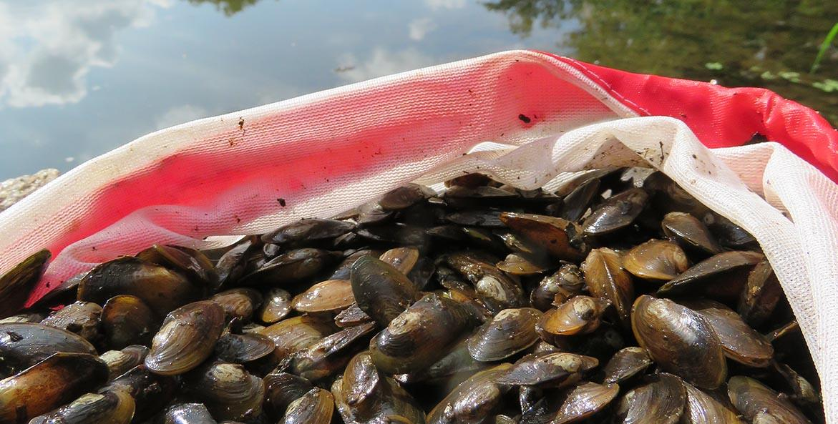
Requiring co-benefits
In addition to reducing tree loss, require projects include at least five of the following:
Creation or restoration of wildlife habitat, riparian buffers, and wetland restoration
Restoration of aquatic resources: freshwater mussels, fish passage, or oyster reefs
Carbon sequestration
Climate change mitigation, adaptation, or resilience
Local employment opportunities
Improving and protecting public health
Provision of recreational opportunities and public access to waterways and natural habitats
Photo credit: Chesapeake Bay Foundation

Slide 6
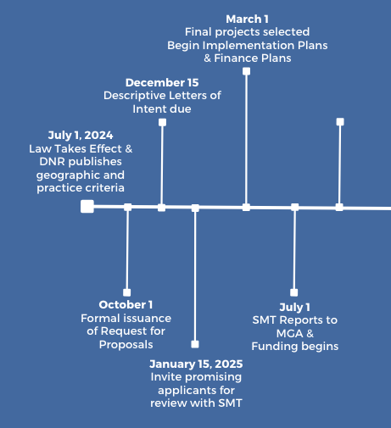
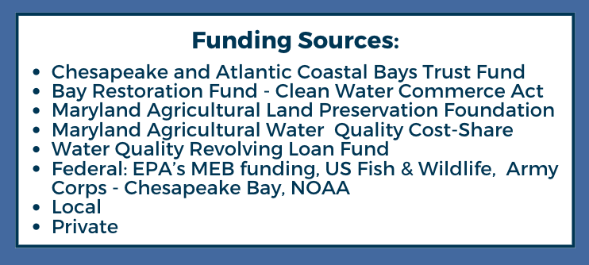
Streamlining the timeline & bundling the funding

Slide 7
Whole Watershed Act
Bigger:
Smarter:
Bolder:
Faster:
Utilizing 8-digit watersheds
Targeting the watersheds that need the most attention
Requiring multiple co-benefits in order to ensure more holistic projects
Ensuring DNR, MDE, MDA, other state, local, and federal partners work together to responsibly streamline permitting and implementation

Slide 8
Whole Watershed Act
Focus on watersheds that present opportunities for most significant impact on a (relatively) expedited timeline with coordination between State, local, and private partners
Projects selected to represent different geographic & land use types and will prioritize Environmental Justice communities
Requirement of multiple co-benefits to support the health of the whole watershed & community
State Management Team consisting of multiple State agencies and more to select projects, monitor and support progress, and expedite the permitting process
Pilot Deployment Teams consisting of NGOs, local governments, affected landowners, private industry
New certification for developers & contractors who complete restoration projects to uphold standards & ensure quality

