Slide 1
CWP Stream Restoration: Finding Common Ground Webinar #3
Assessing Alternatives:
Tools and Best Practices to Restoration Approach Selection
June 18, 2024
Presented by:
Ben Uhler
LandStudies, Inc.
Design | Sustain | Restore

Slide 2
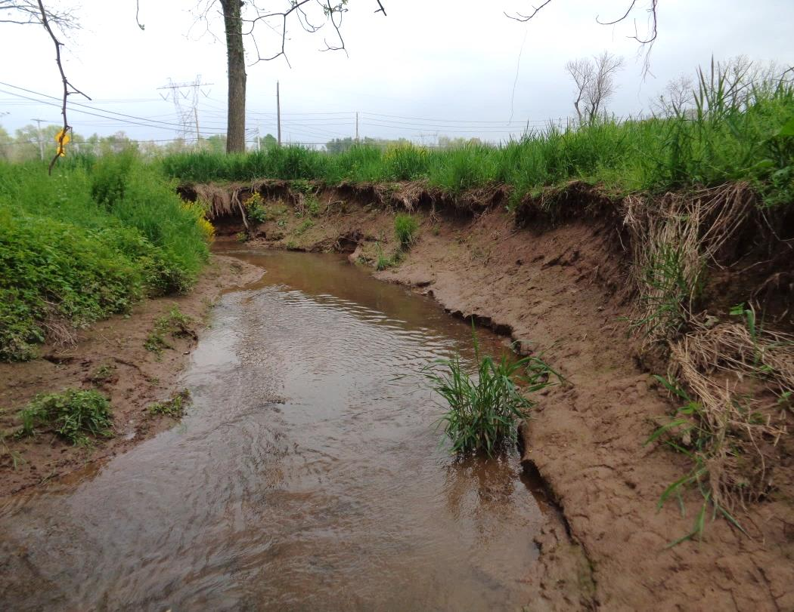
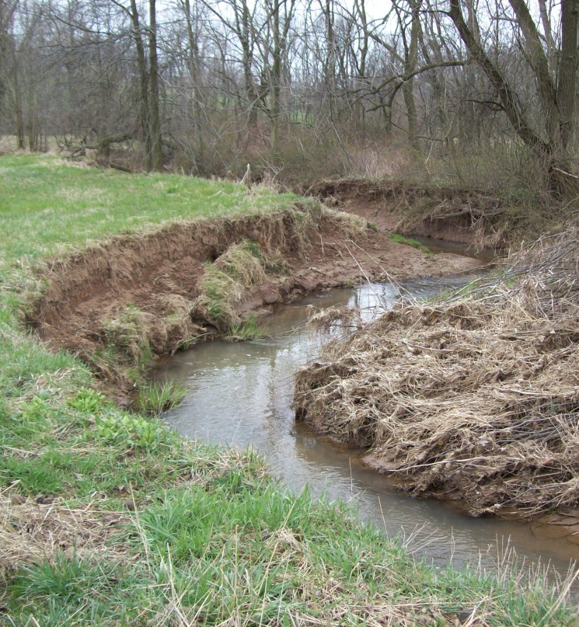
Notes:
Typical unstable conditions including channel incision, high banks, lateral erosion, channel disconnected from its floodplain. This is not a natural condition.

Slide 3
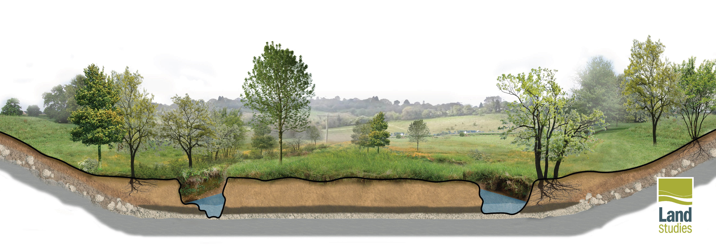
Impaired Condition
Notes:
…. Often the result of anthropogenic influences especially within the last few hundred years.

Slide 4
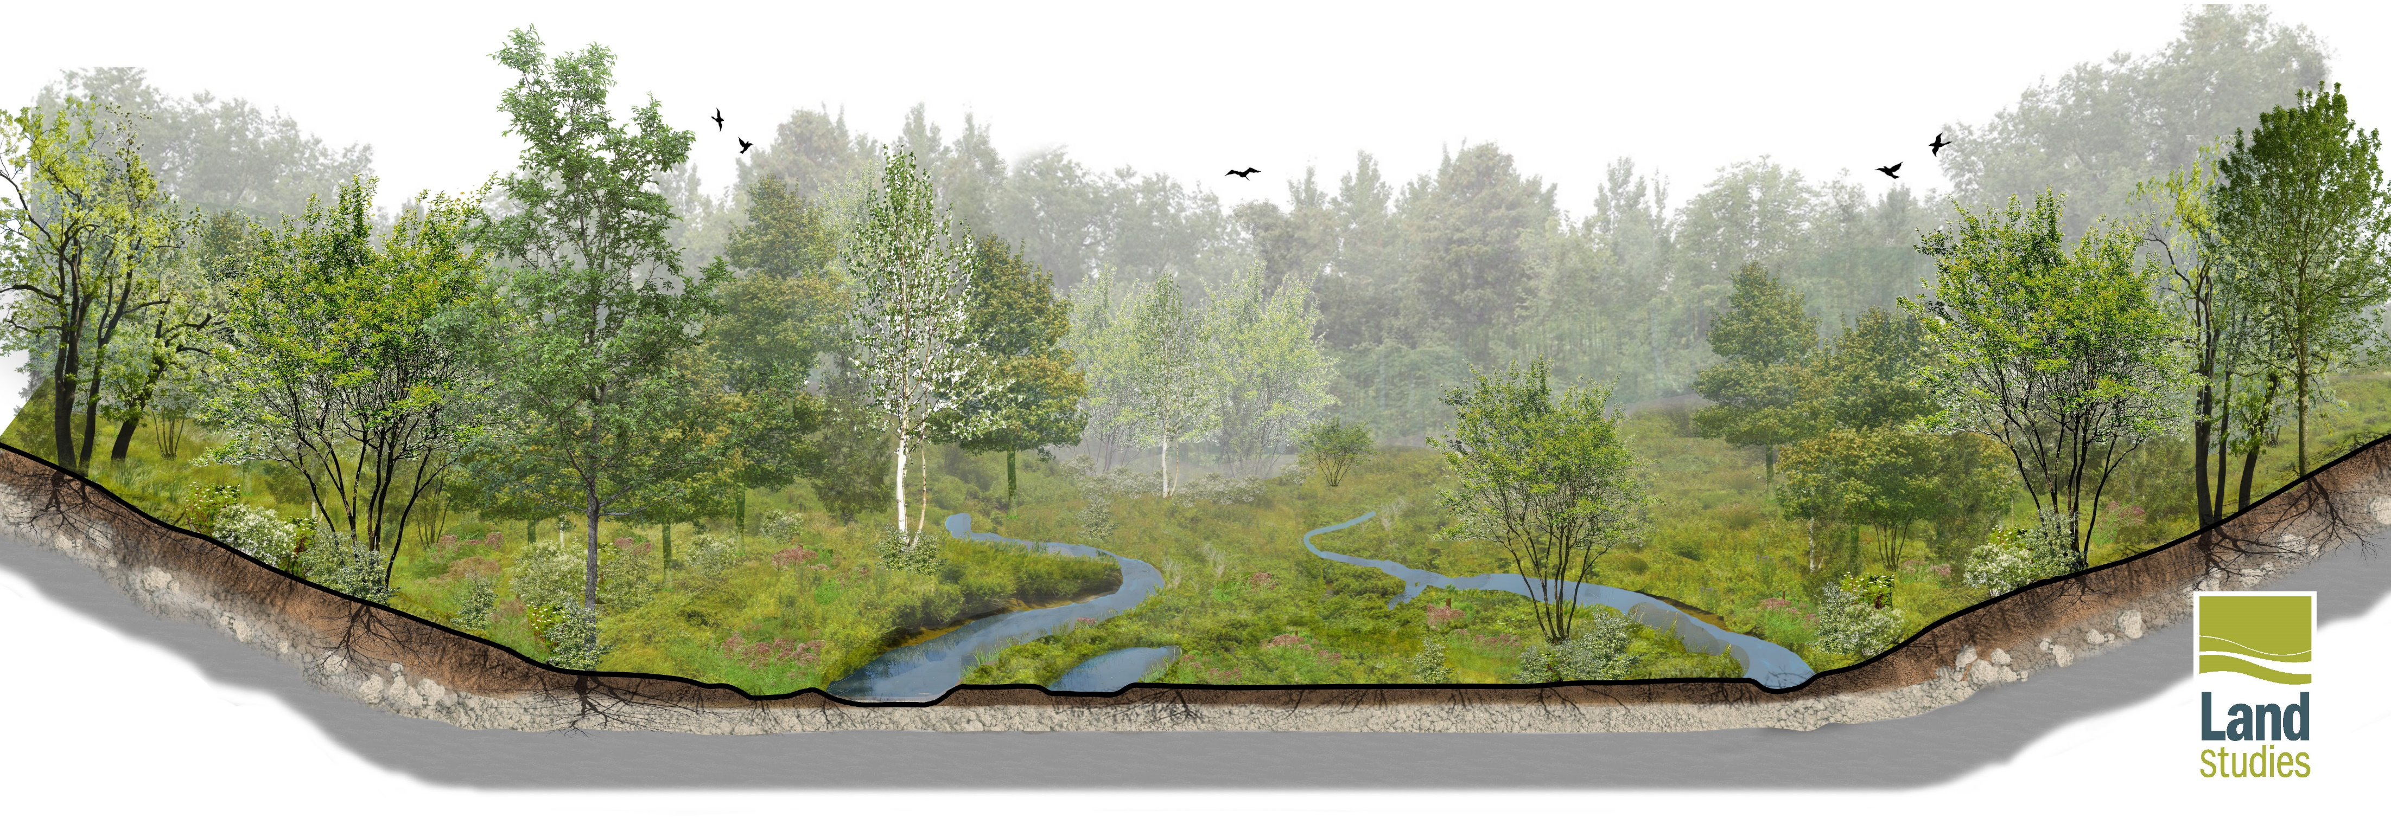
Natural Condition
Notes:
The natural condition was very different than our present-day condition – most channel systems had very low banks.
Anastomosed channels were common, and the riparian wetlands were well-connected, which fostered robust and resilient ecosystems.
Research has indicated that most valley bottoms were dominantly herbaceous and scrub-shrub mosaic, not forested.
Perhaps this can be attributed to the fact that most valley bottoms were home to beaver who were a vital part of the sustainable ecosystem.

Slide 5
RESTORATION:
"return of an ecosystem to a close approximation of its condition prior to disturbance."
National Research Council (Restoration of Aquatic Ecosystems, 1992)
Notes:
Restoration is returning an ecosystem to a close approximation of its condition prior to disturbance.
The term restoration is often used as a blanket description for all types of stream improvements. There is a big difference between restoration and stabilization.

Slide 6
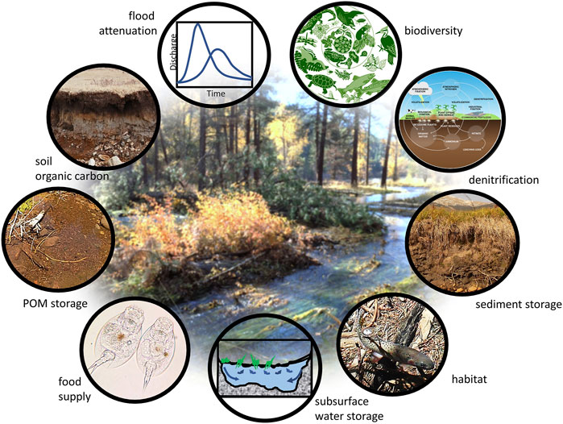
Why Floodplain Restoration?
Credit: Wohl et. al. 2021
Notes:
Restoration looks at things comprehensively and can return a multitude of desirable functions and values.
Aquatic ecosystems are complex… complexity is good, complexity is resilient. Resilience is sustainable.
This sustainability is quite attractive for a variety of project drivers where a lot hinges on a project being successful….

Slide 7
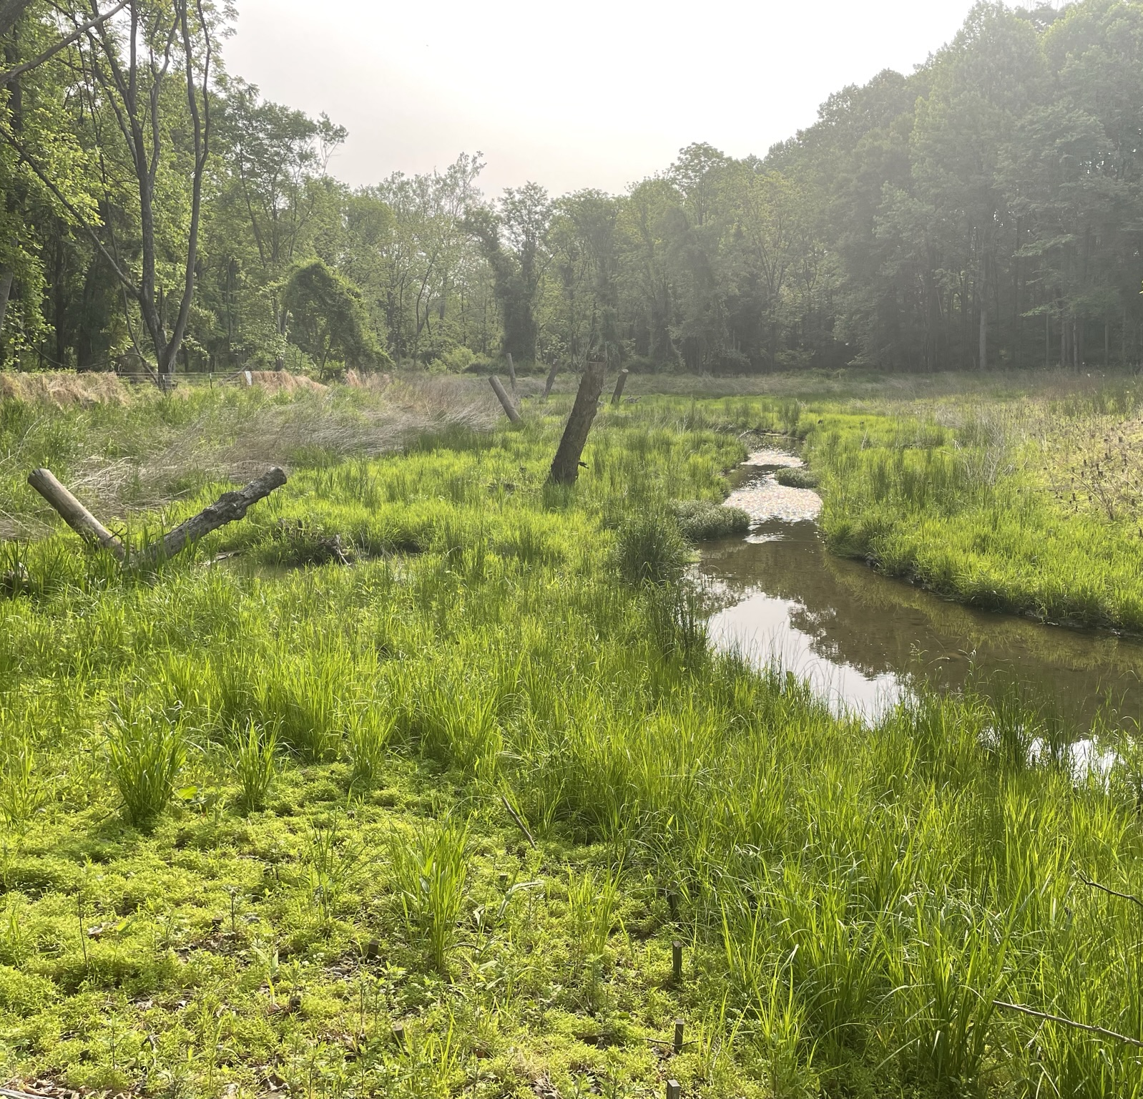
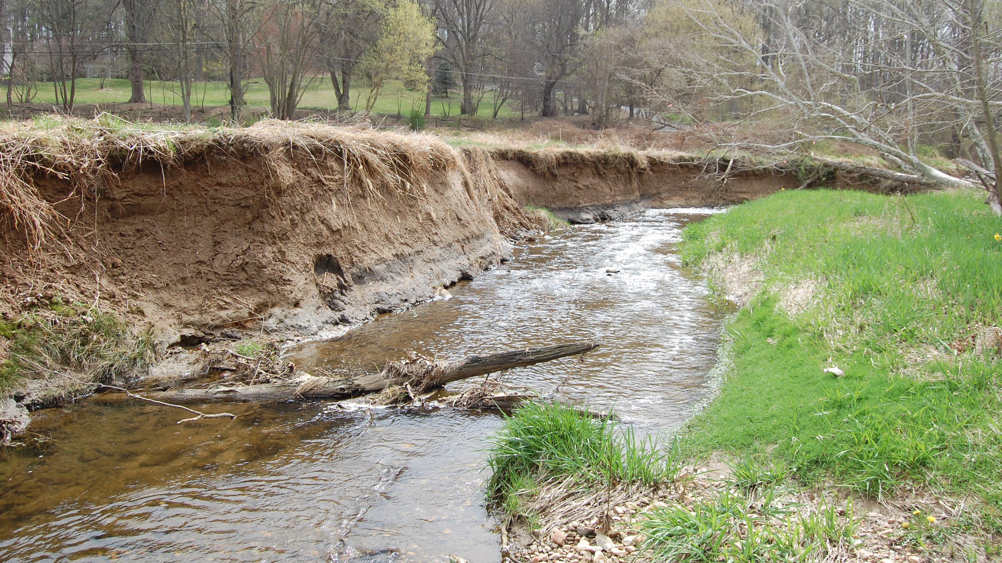
Pollutant Load Reductions

Slide 8
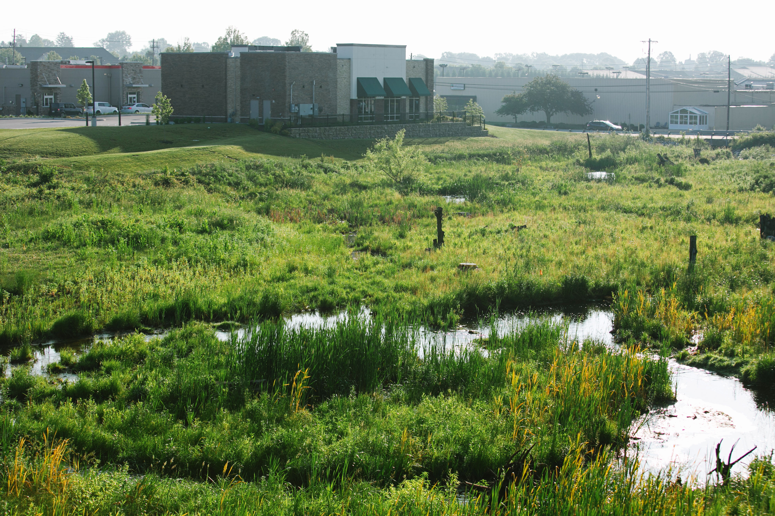
Compensatory Mitigation

Slide 9
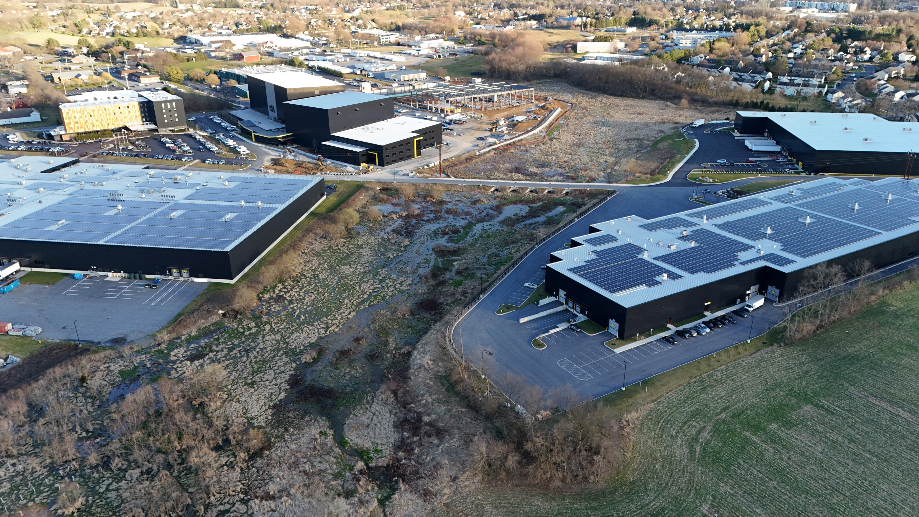
Stormwater Management
Notes:
This is a project where all stormwater associated with a large-scale commercial development is managed within the floodplain rather than conventional stormwater BMPs such as basins, which proved to be a very cost-effective approach.

Slide 10
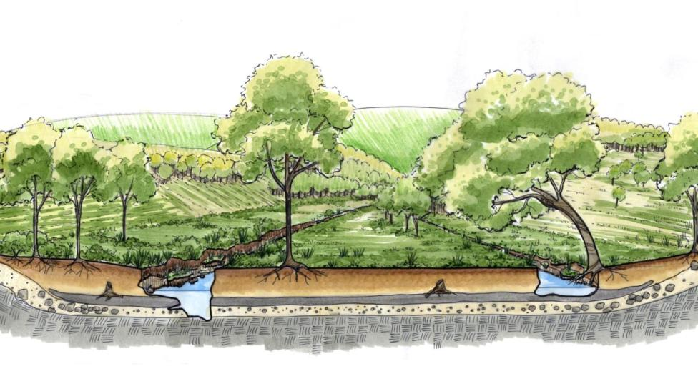
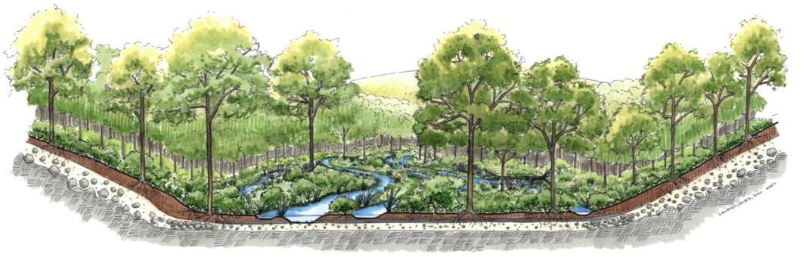
Design Approach – Legacy Sediment Removal
EXISTING CONDITIONS
Bedrock
Pre-Settlement Floodplain Soils –
Shallow, Peaty,
Organic, & Porous
Basal Gravel
(Groundwater)
PROPOSED CONDITIONS
Roots extend
to groundwater
Notes:
One approach is legacy sediment removal, which involves excavating the legacy sediments from the valley and establishing lower floodplain elevations much closer to the pre-settlement condition. Perhaps the most key component of this approach is maximizing the hyporheic zone as this sets the stage for achieving the multitude of functions and values mentioned earlier.

Slide 11
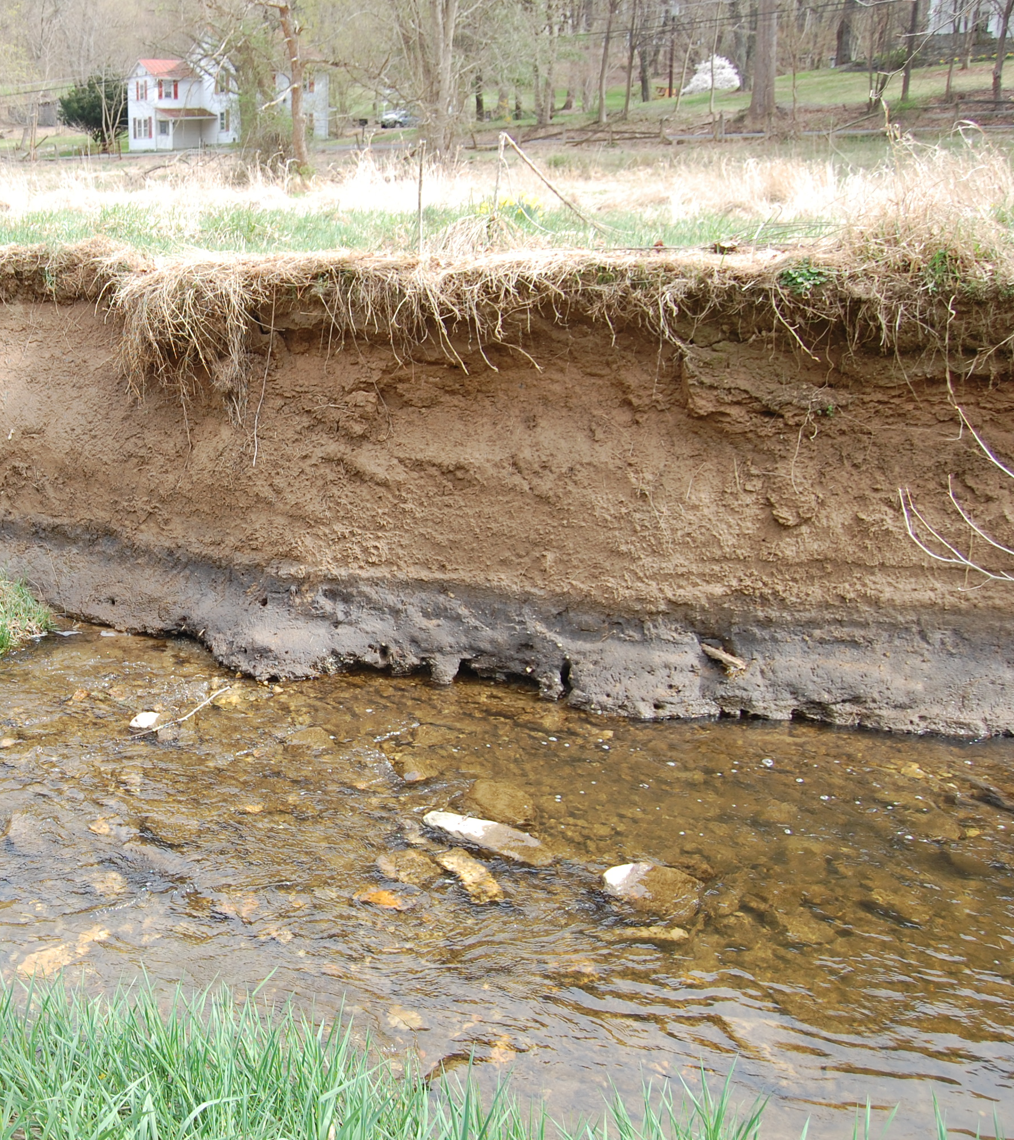
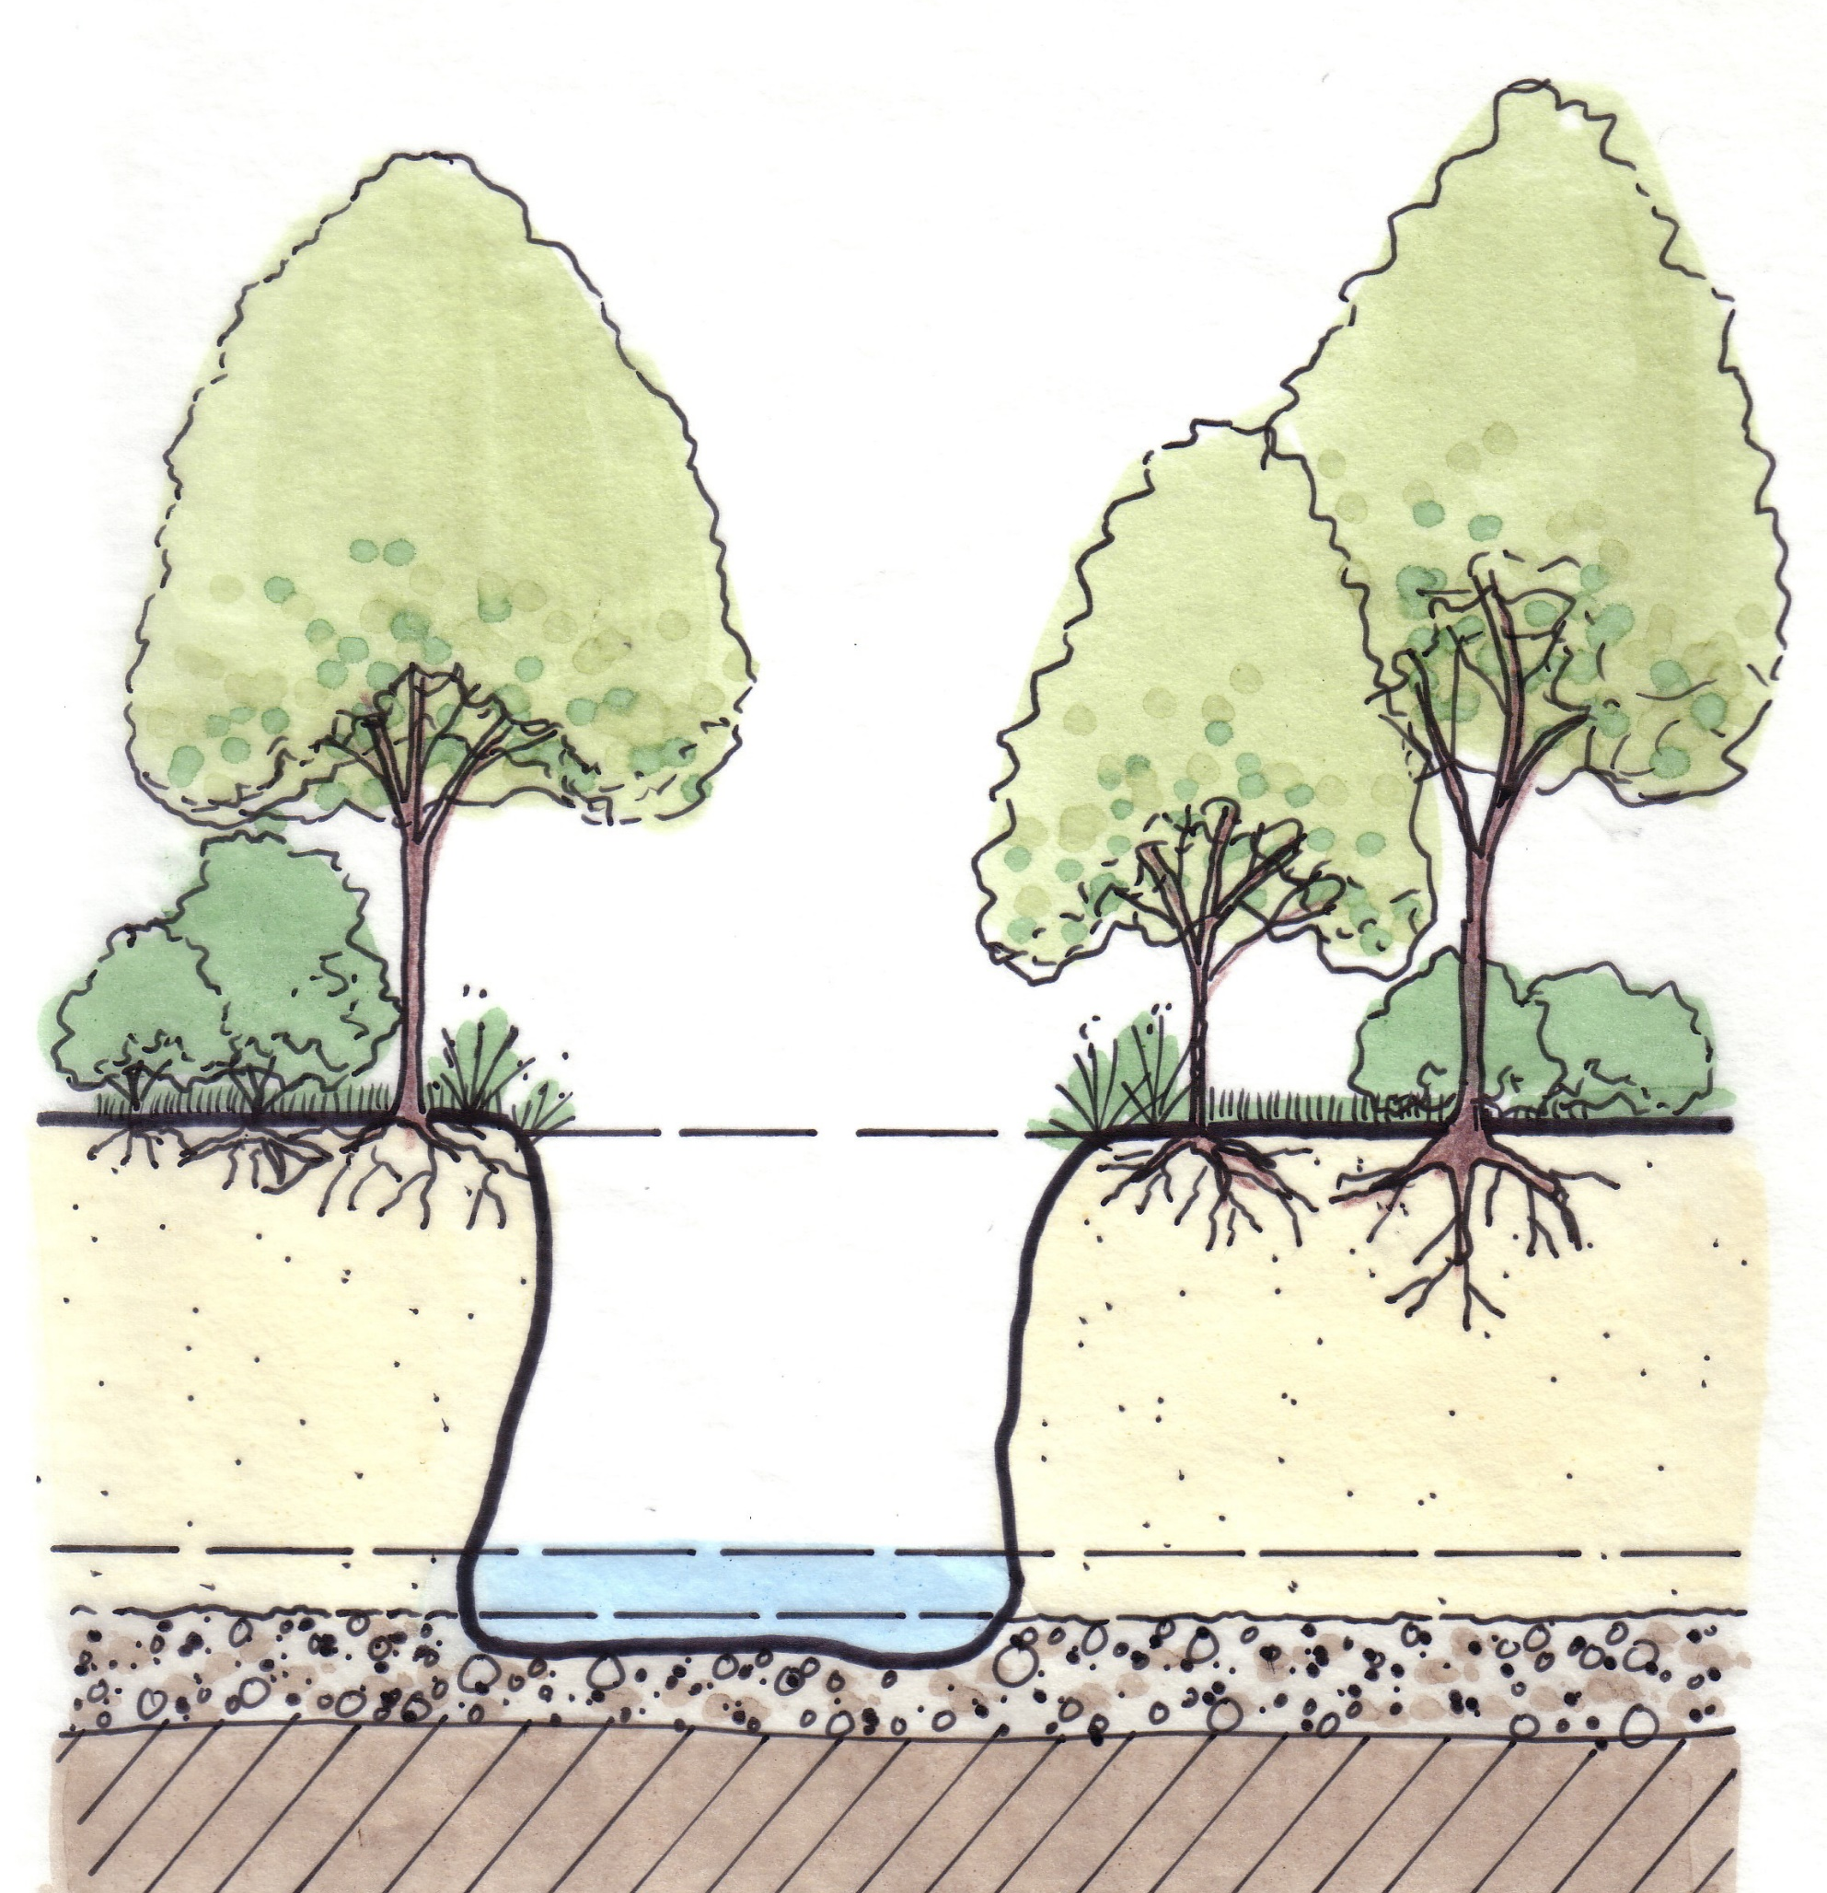
Flood Flow Elevation
Root Zone
Legacy Sediment
Base Flow
Pre-Settlement Floodplain
Colluvial Gravel
Bedrock
© 2005 LandStudies, Inc. www.landstudies.com
Notes:
Cut-banks like this can be very helpful in displaying past accumulation of legacy sediment.

Slide 12
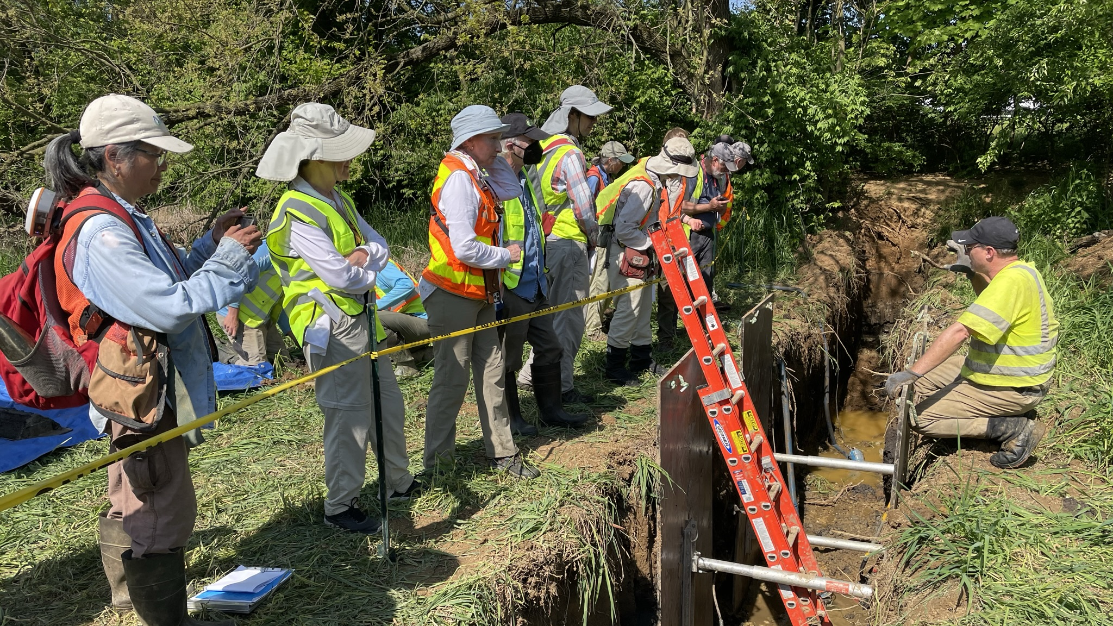
Notes:
Sometimes cut banks are not as helpful because the pre-settlement layer can actually be evacuated during high flows.
As such, one of our preferred assessments is to dig exploratory trenches in the floodplain.
This can provide the most reliable and well-preserved information and reveal details about the natural condition that are otherwise hidden.
Sometimes subsurface observations are performed while the trench is open.
Other times, we extract soil monoliths for closer examination in a lab.

Slide 13
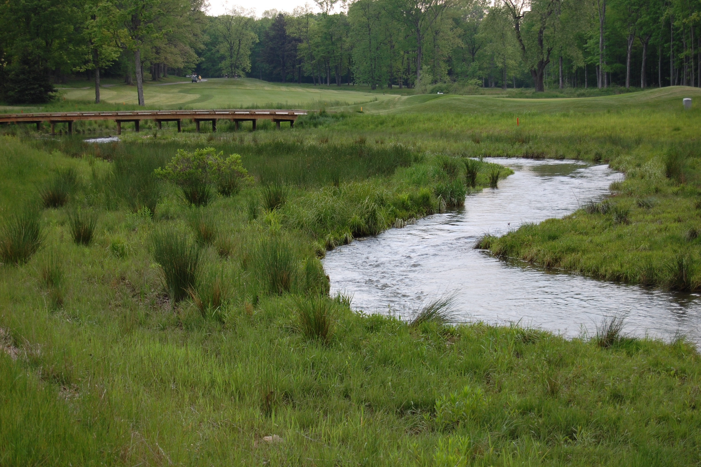
Project Example
Before
After
Notes:
Here is a before and after of a legacy sediment removal project at a golf course in western Pennsylvania.
The list of benefits for is long – addressing property loss due to erosion, reduced maintenance, local flood reduction, invasive species removal, educational and recreational opportunities, and in the case of legacy sediment removal, generation of fill material that can improve upland portions of a particular property.

Slide 14
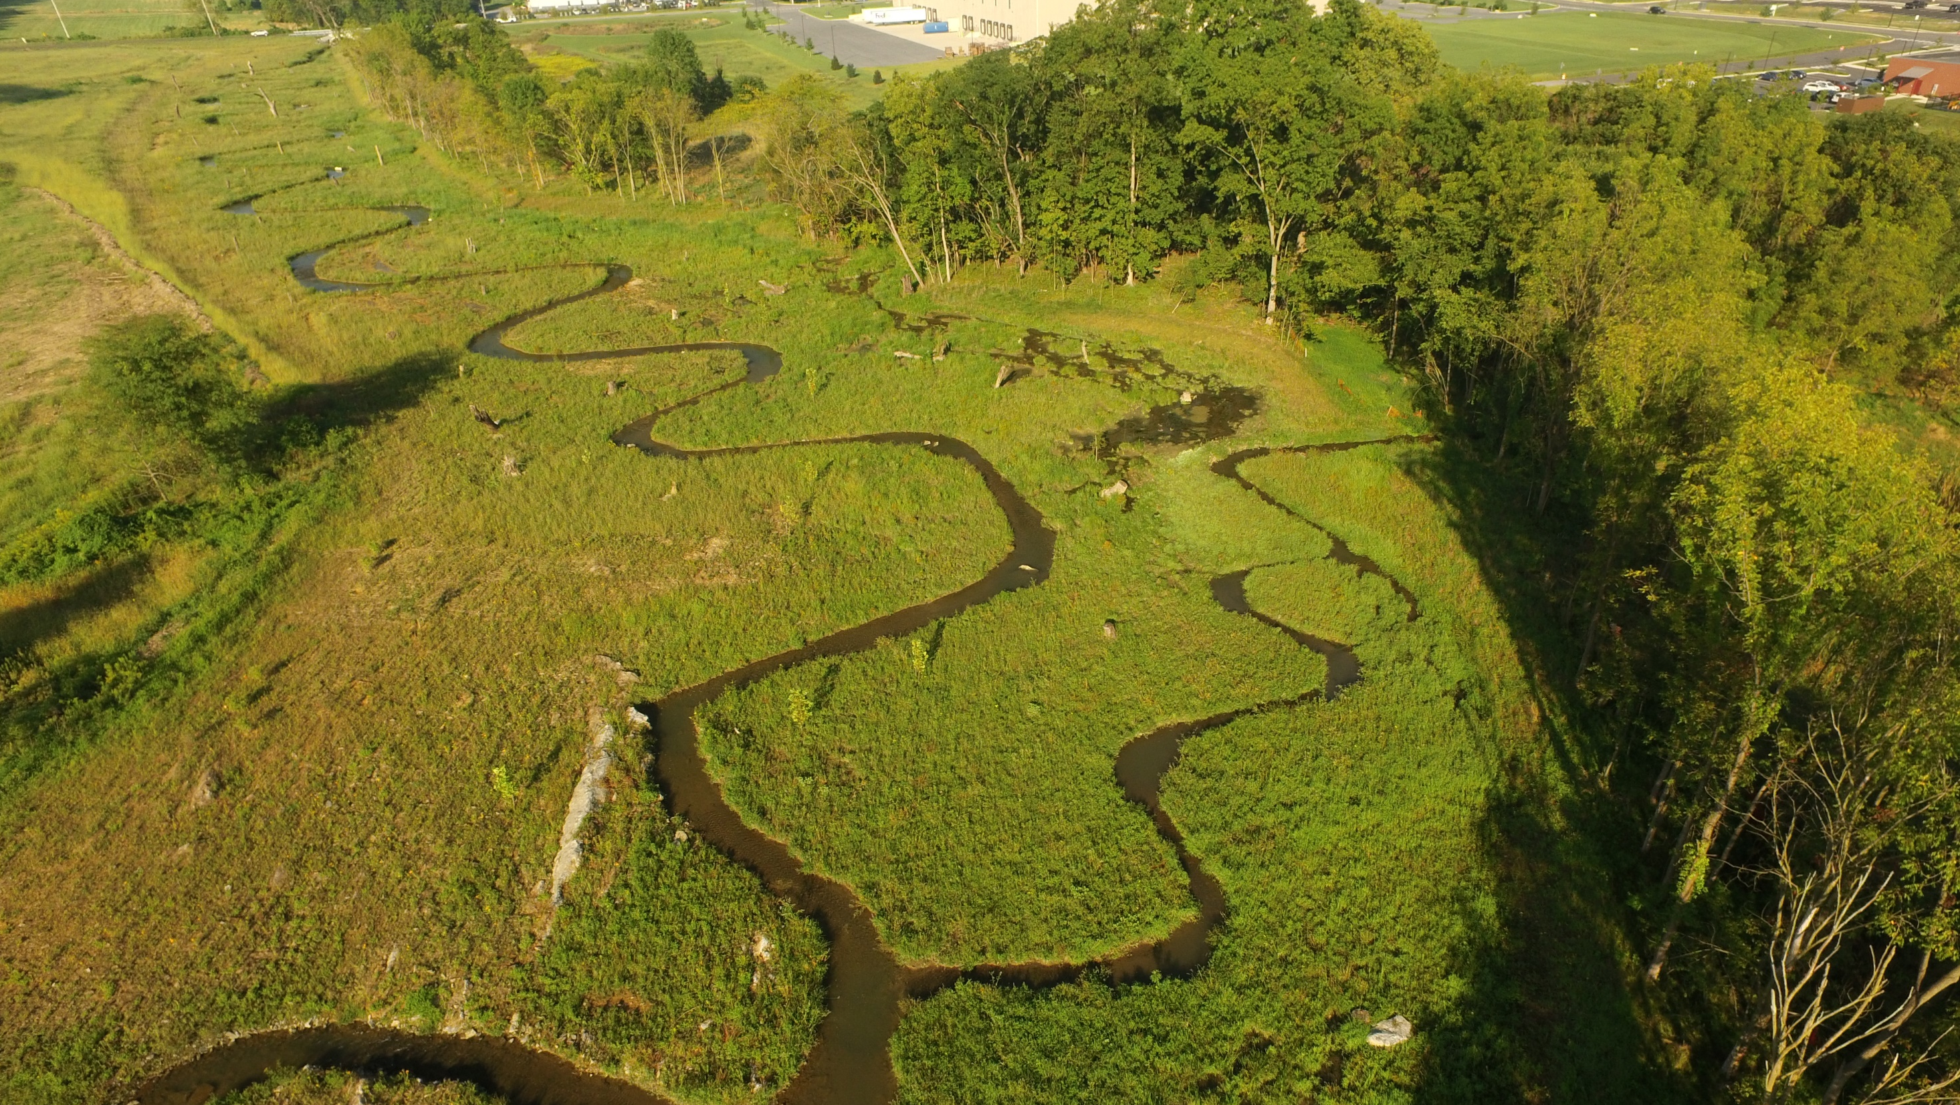
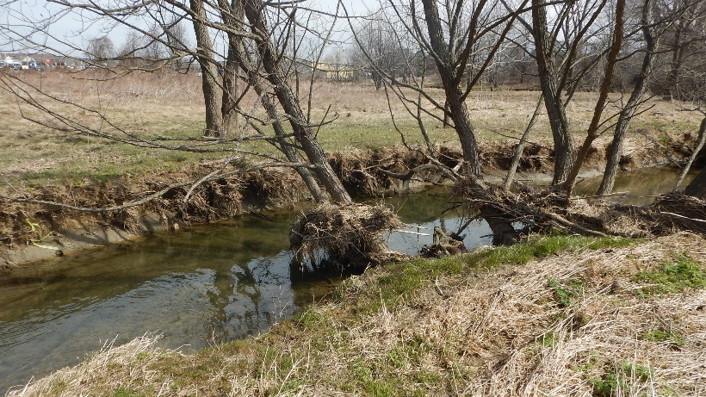
Pre-Restoration
Post-Restoration
Notes:
This design approach focuses on maximize floodplain width to encourage flood flows to spread out, lowering flood flows depths and thereby minimize shear stress.
A baseflow channel system is designed when appropriate.
This can sometimes be a single-thread channel ….

Slide 15
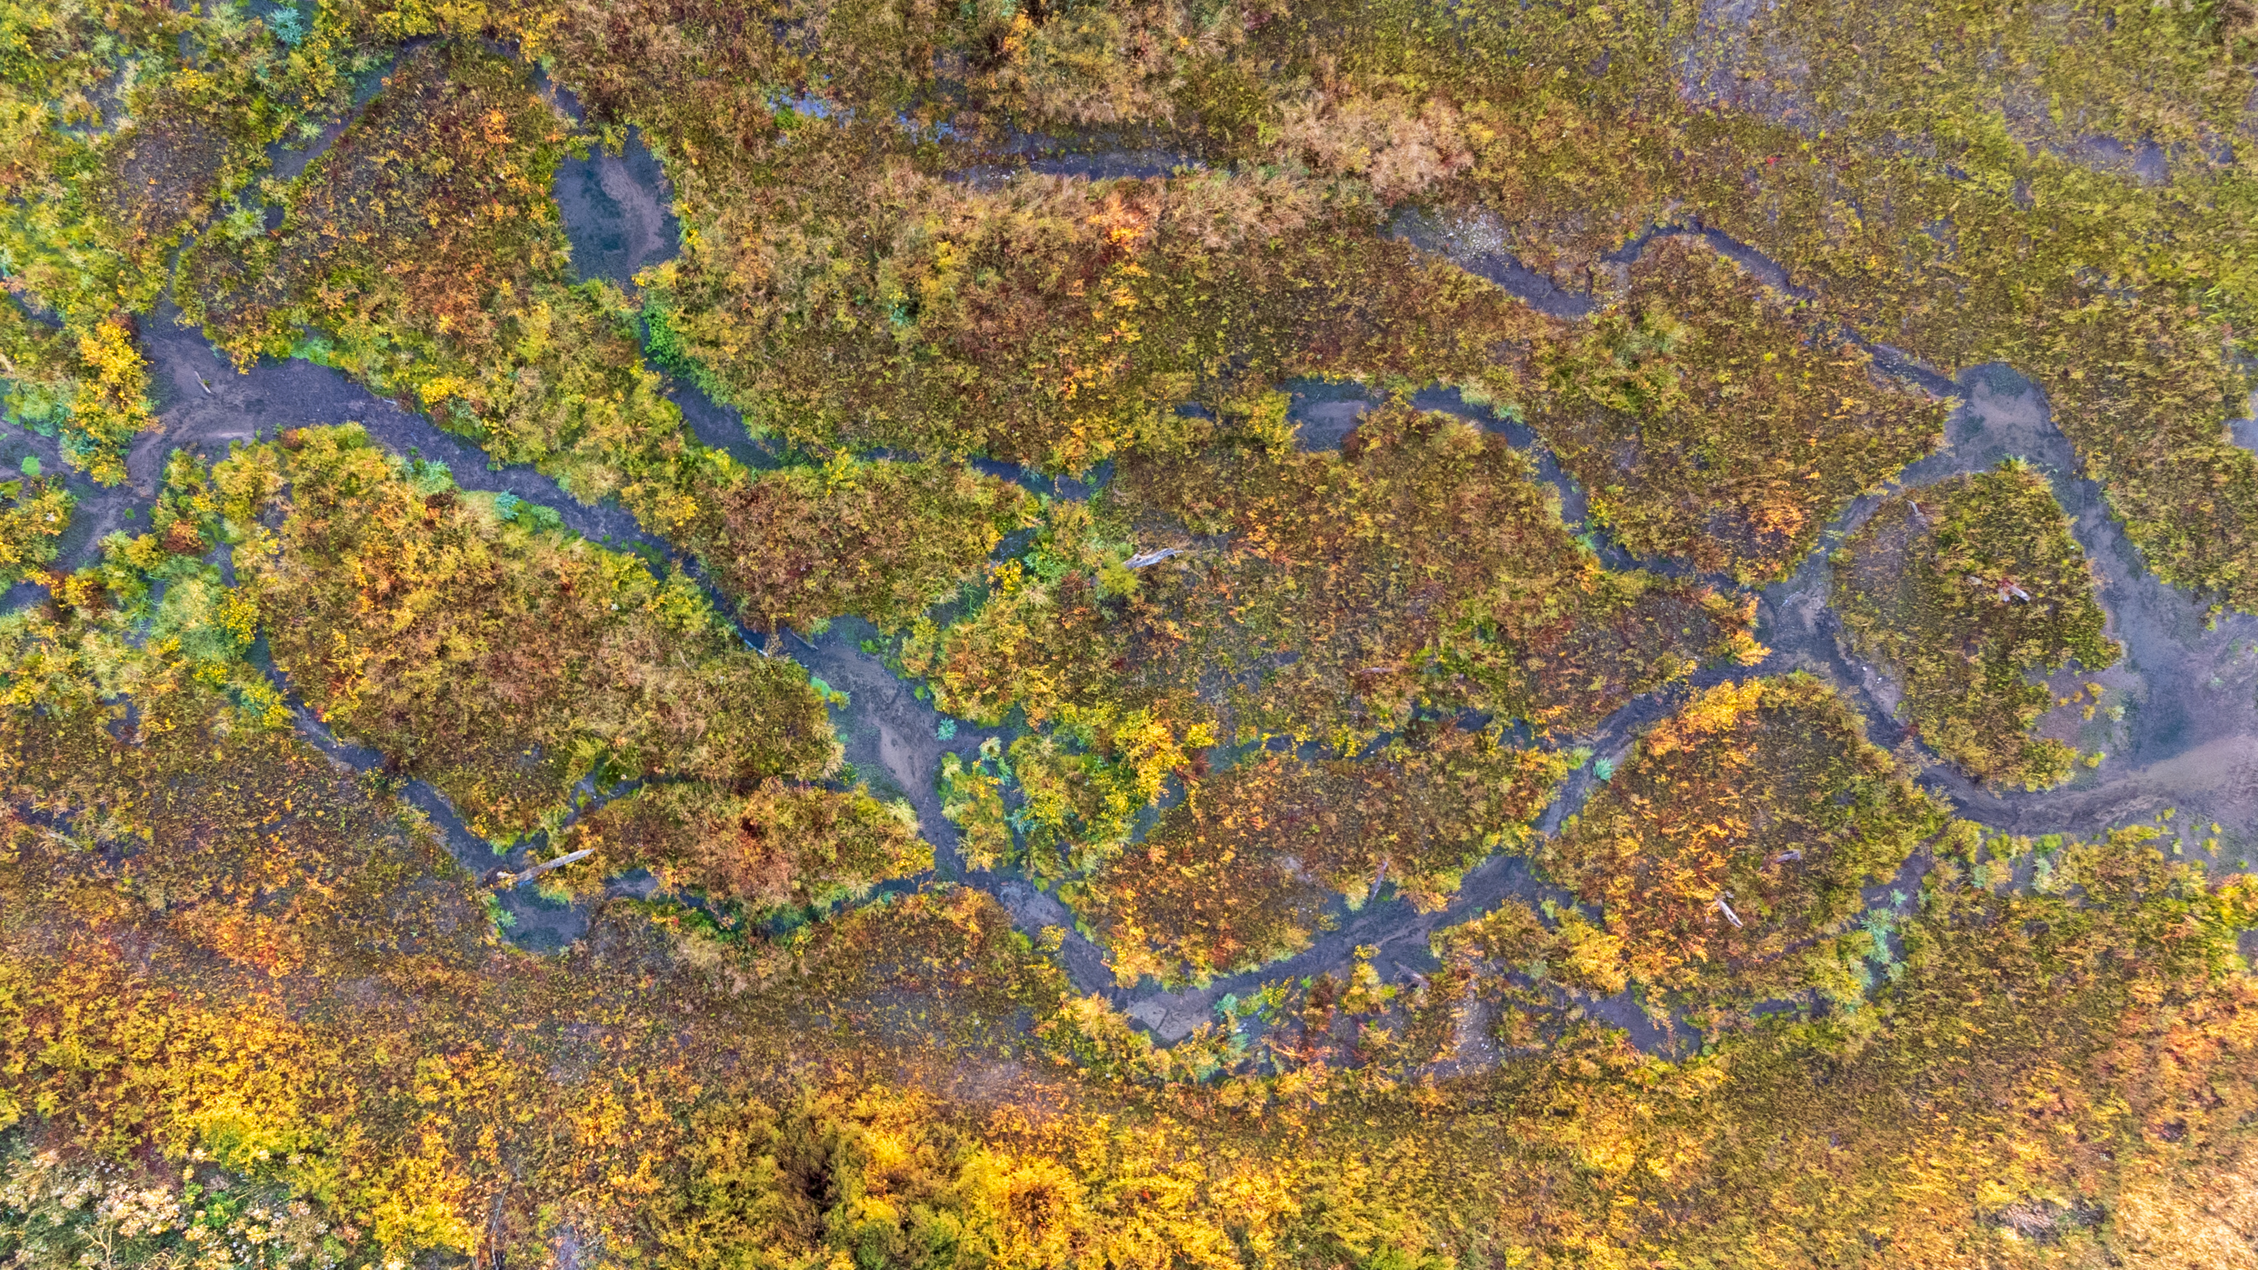
Notes:
…. or multiple thread channels or sometimes no channel at all.
If a system is impacted by legacy sediment, then the removal of this material should be considered as a viable and preferred restoration option when not hindered by constraints.

Slide 16
Misconceptions about Floodplain Restoration
All floodplain restoration projects involve legacy sediment removal.

Slide 17
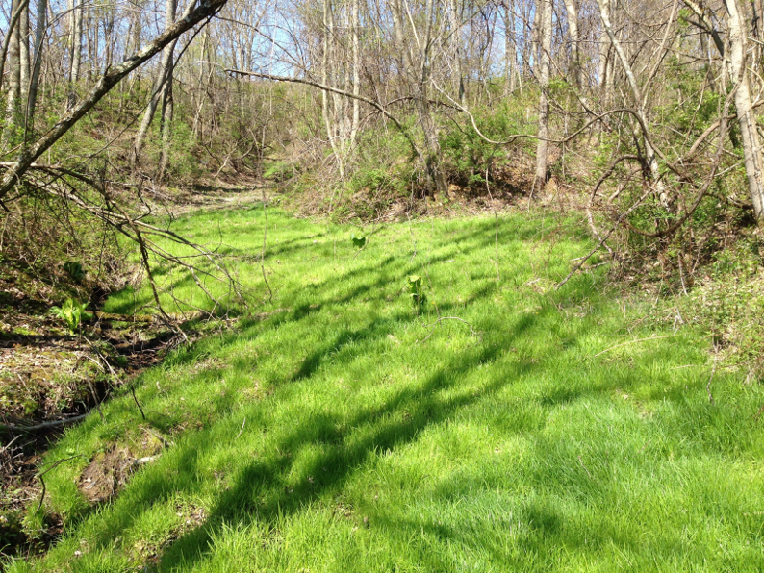
Design Approach – Fill Channel to Match Abandoned Floodplain
Design Elevation
Pre-Restoration
Post-Restoration
Photos courtesy of RES Robinson Fork Mitigation Bank

Slide 18
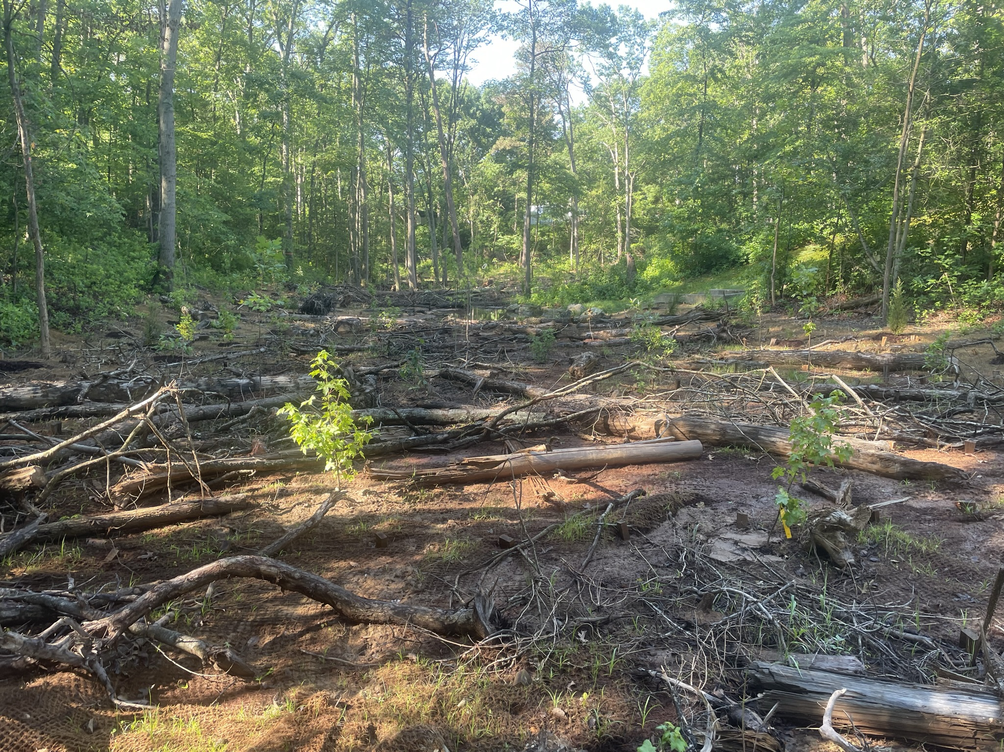
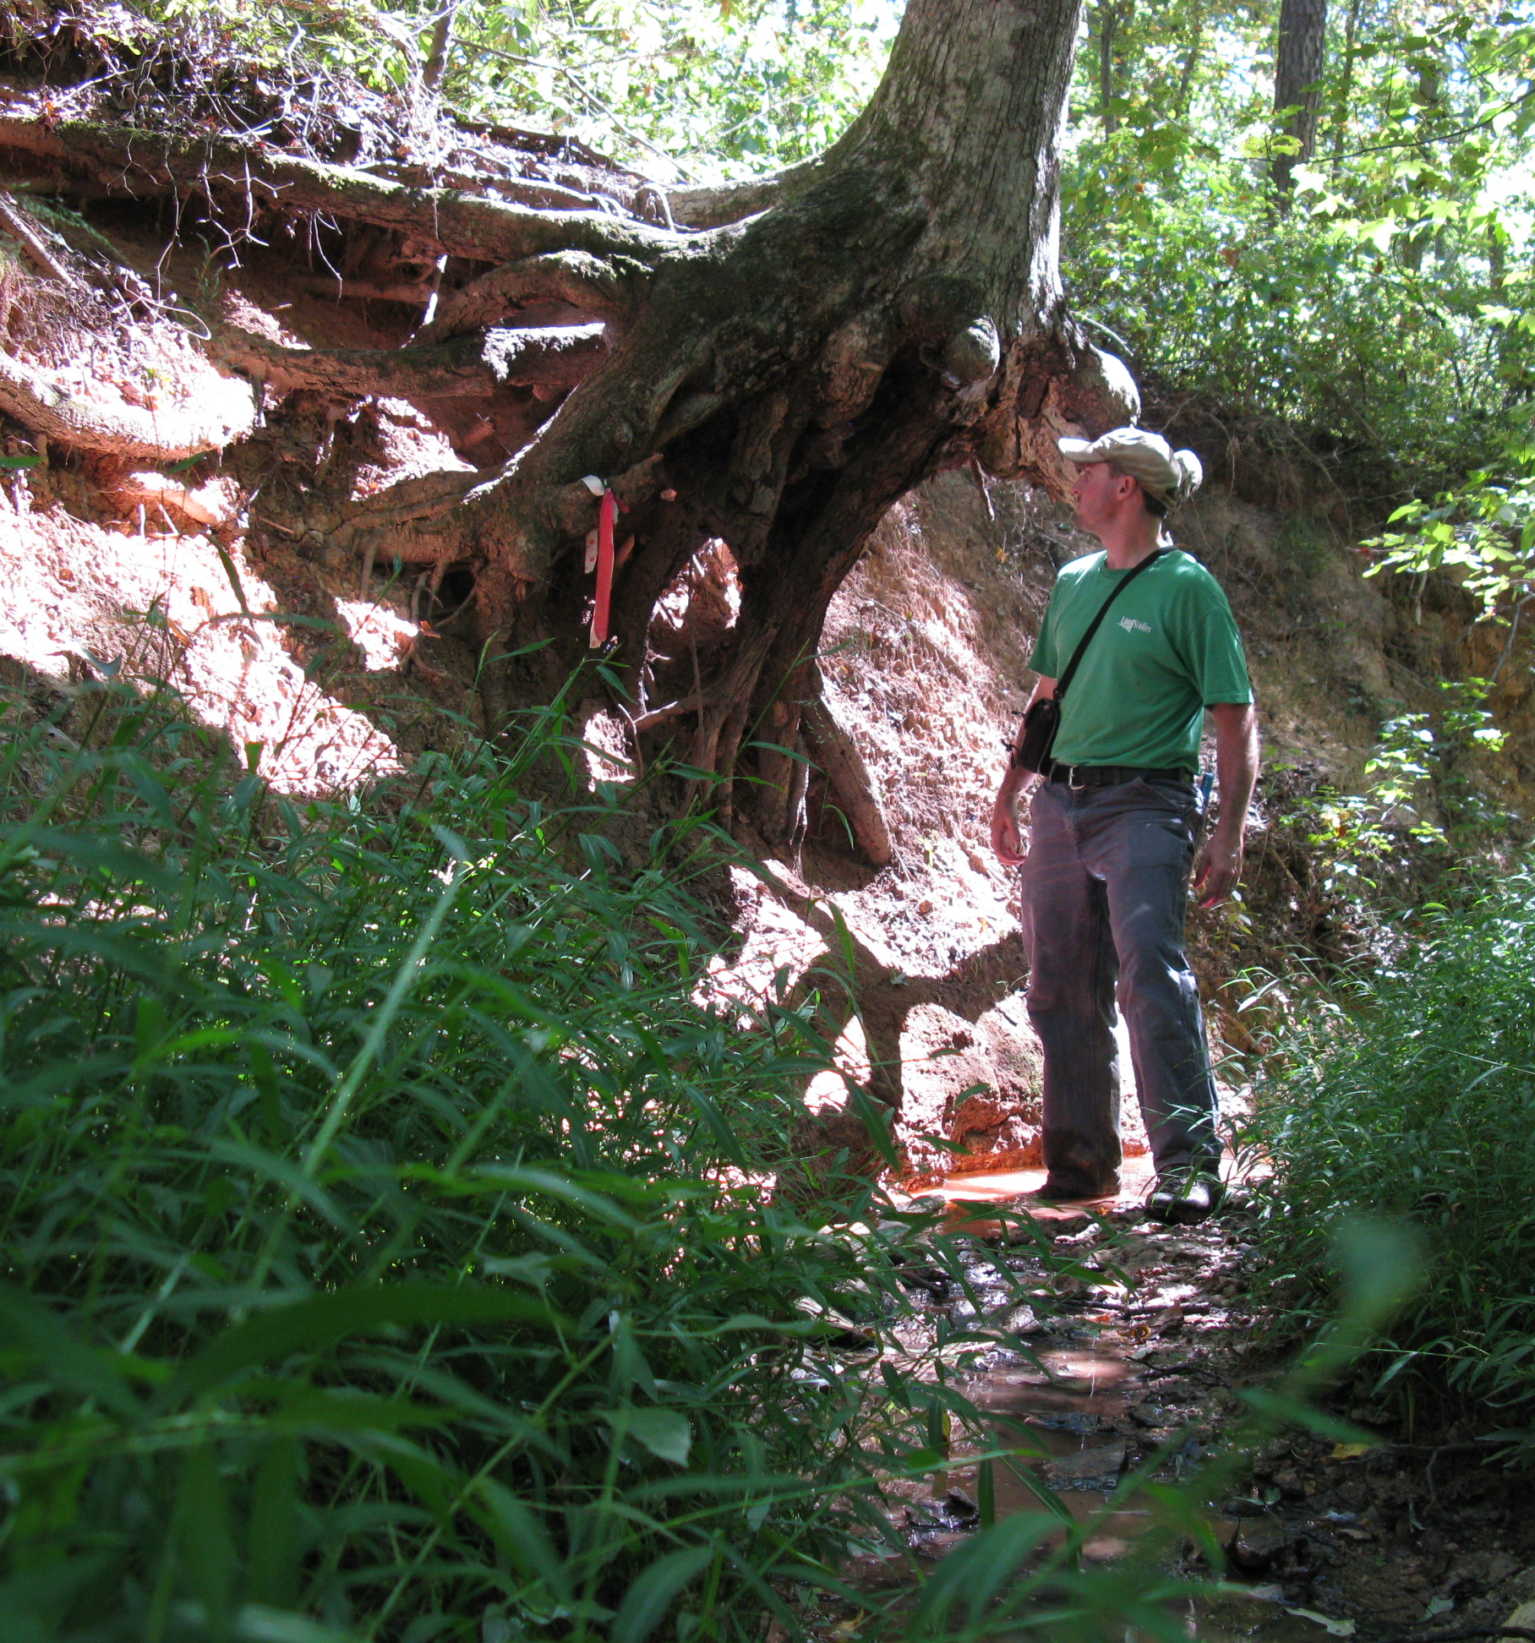
Post-Restoration
Pre-Restoration
Notes:
This is a before and after of a recently completed non-legacy sediment project in Anne Arundel County where an intermittent gully was filled to match the abandoned floodplain.
Disturbance to the existing canopy was minimized but we were able to have enough width to sustainable for the 100-year flow event. No channel was constructed for this one.
Notice the use of woody debris across the floodplain for roughness and habitat. Native woody plants were planted across the full width of the floodplain.
It’s very important to note, when using this approach, it is absolutely critical to make the downstream tie-in stable by sloping the valley gradually.
This may mean proposing a cut in order to match the grade of the downstream channel.

Slide 19
Misconceptions about Floodplain Restoration
Forested floodplains are more stable than floodplains with primarily herbaceous vegetation.

Slide 20
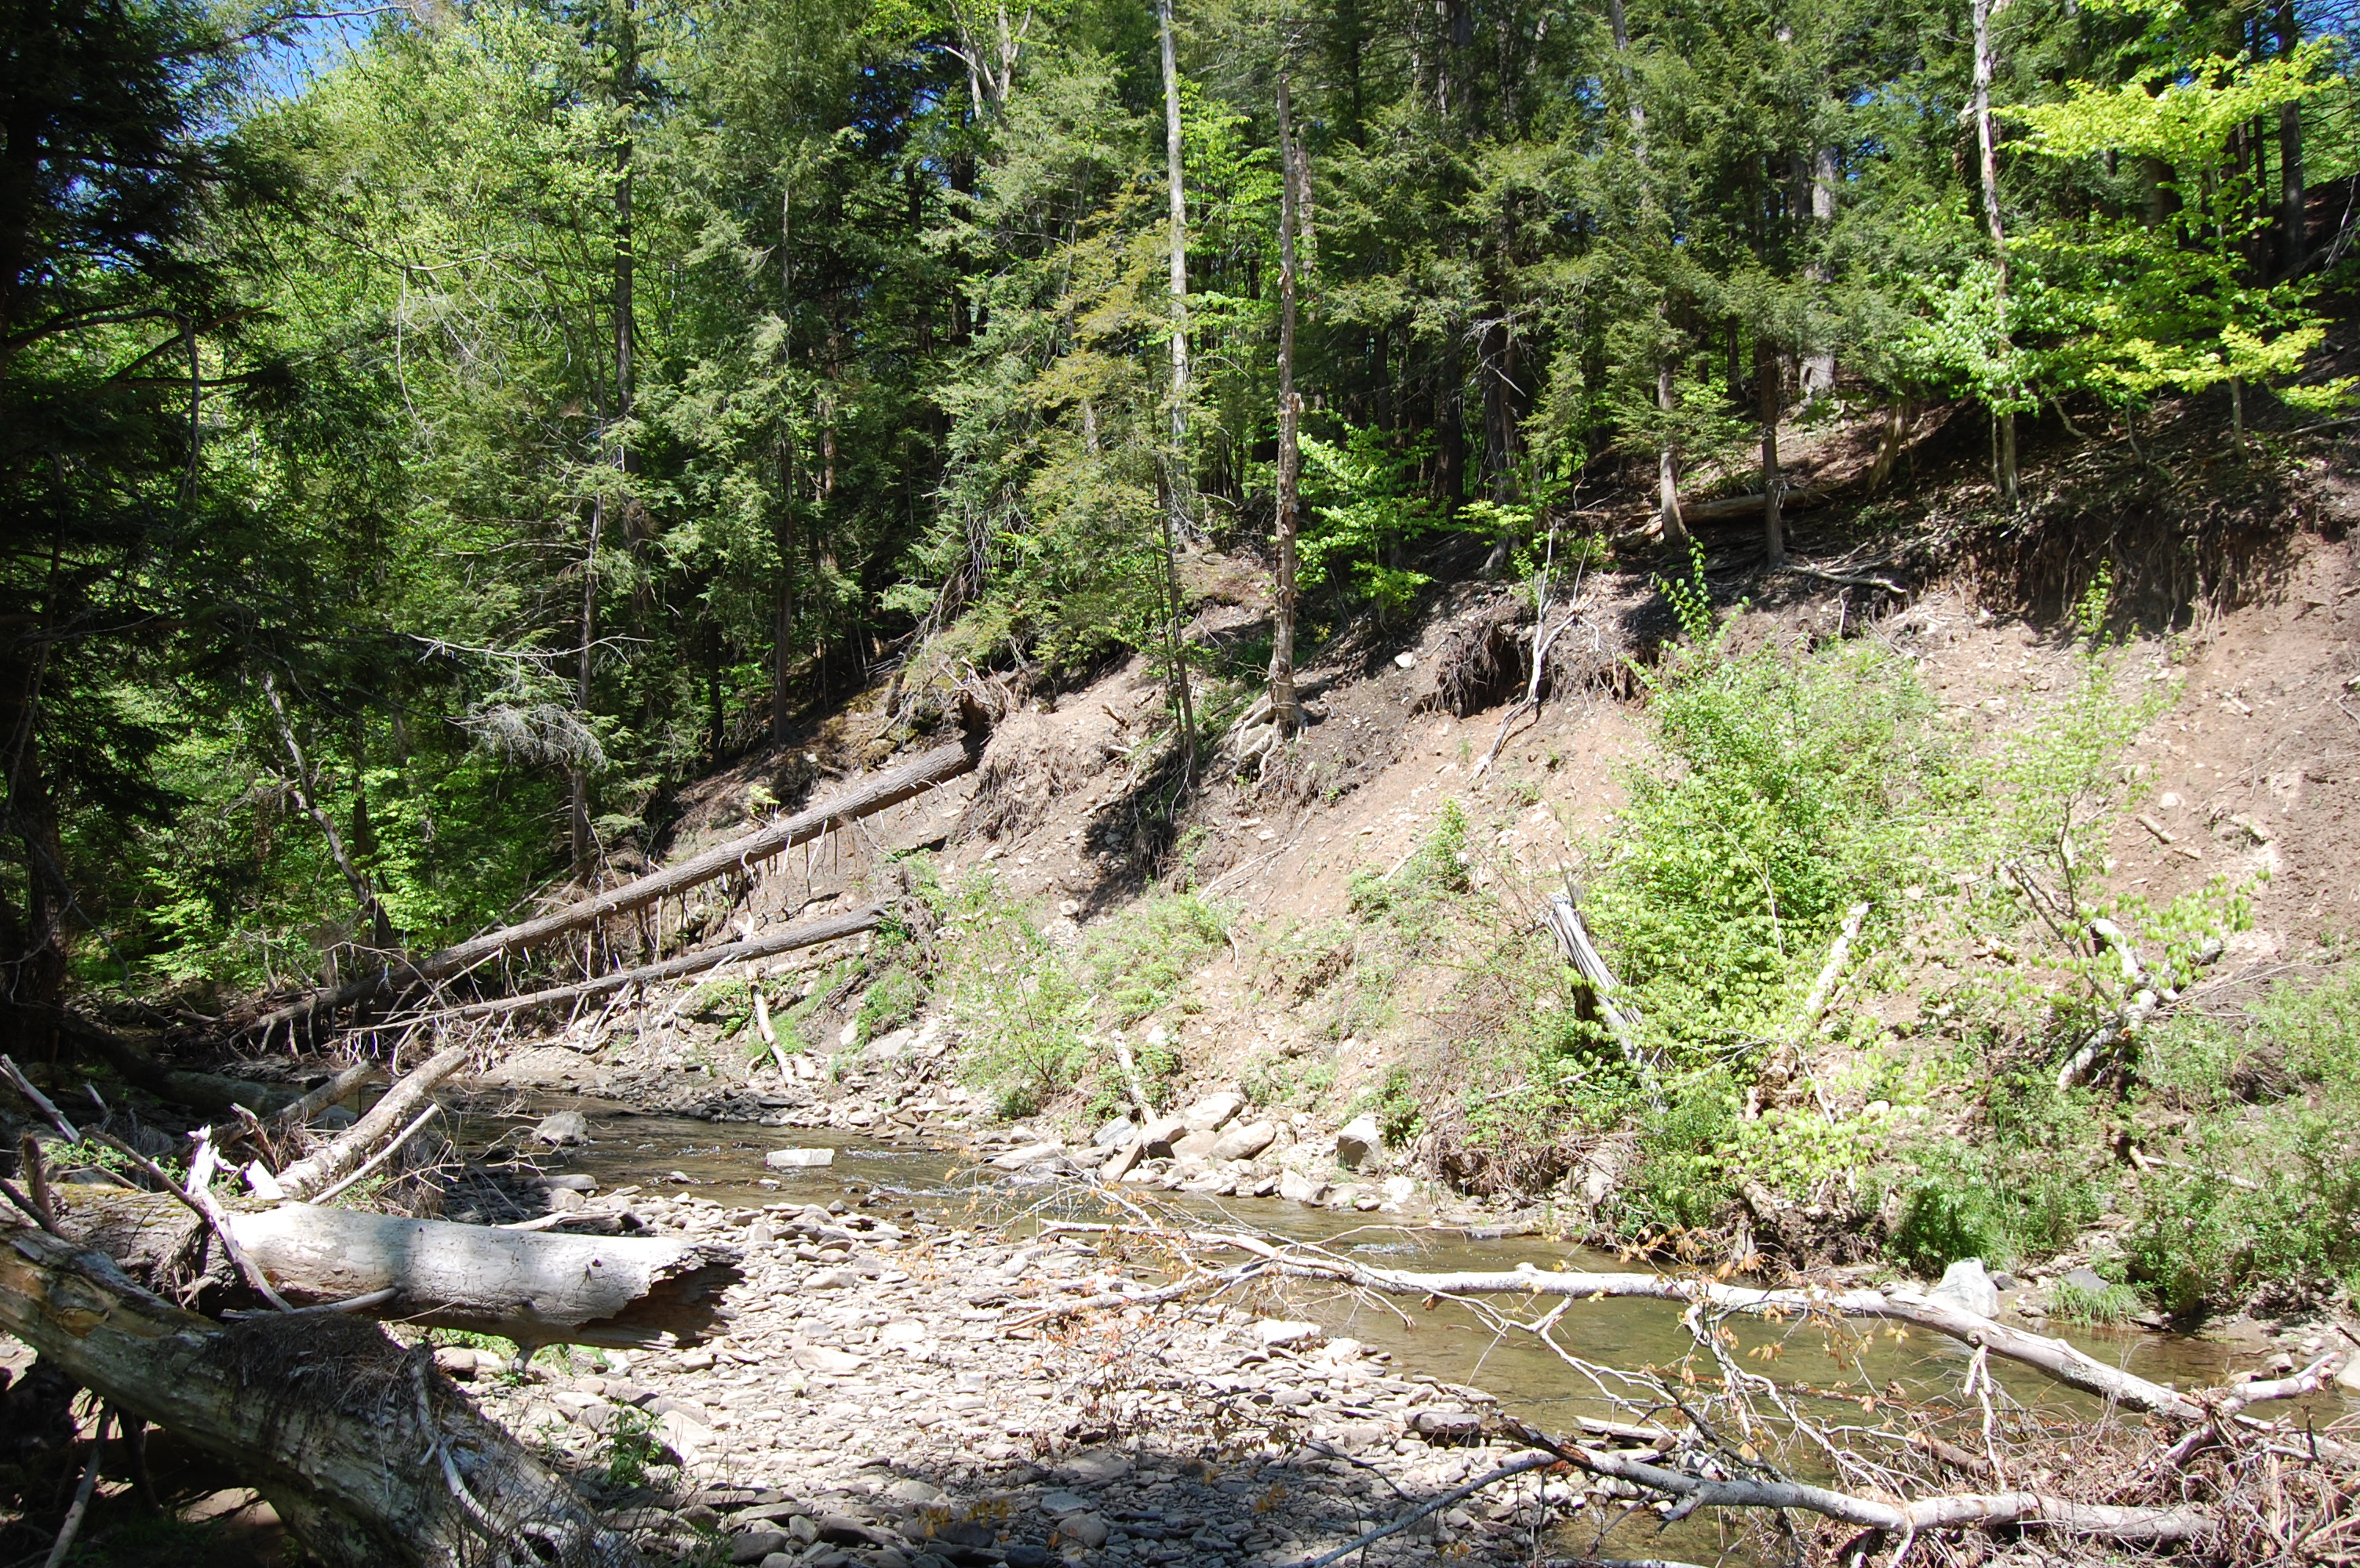
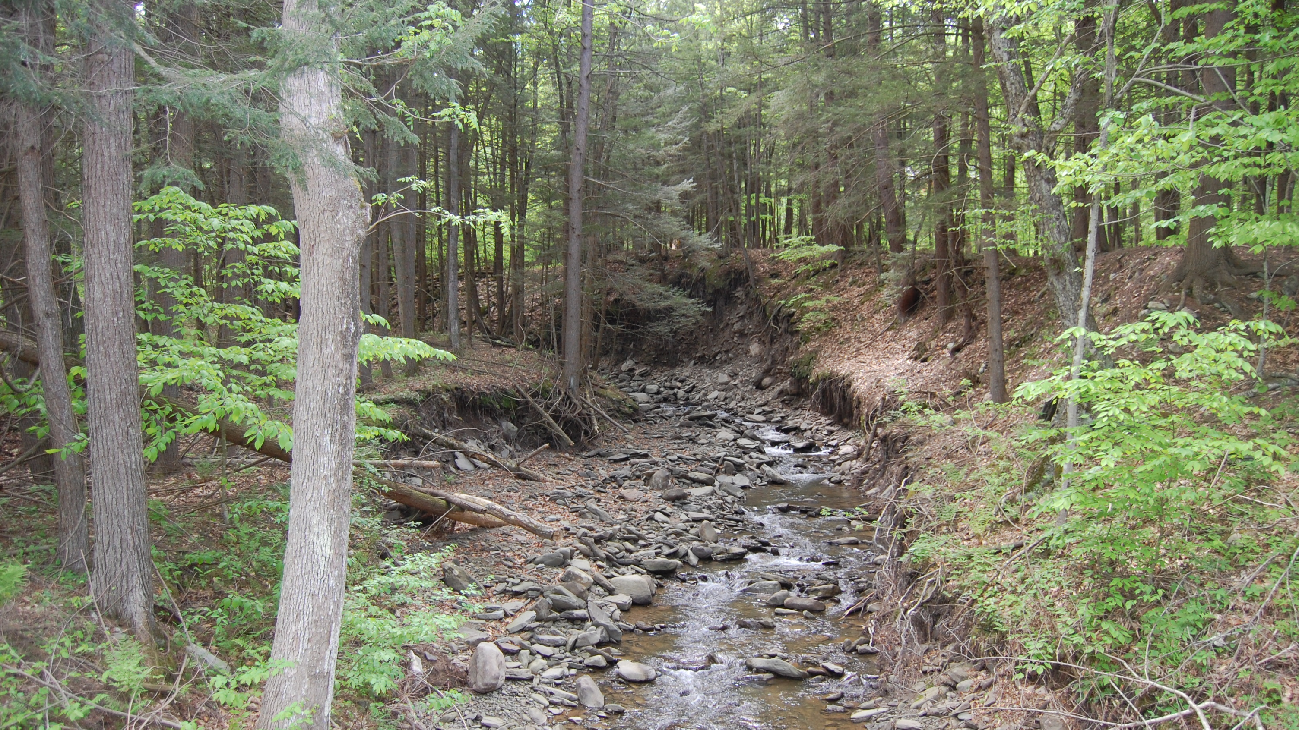
Notes:
Channel instabilities are often disguised or simply harder to see in heavily vegetated or wooded areas, but the unstable condition is quite often very much present.
Extreme bank erosion and slope failure in forested stream valleys is very common showing that tree roots are clearly not protecting stream banks

Slide 21
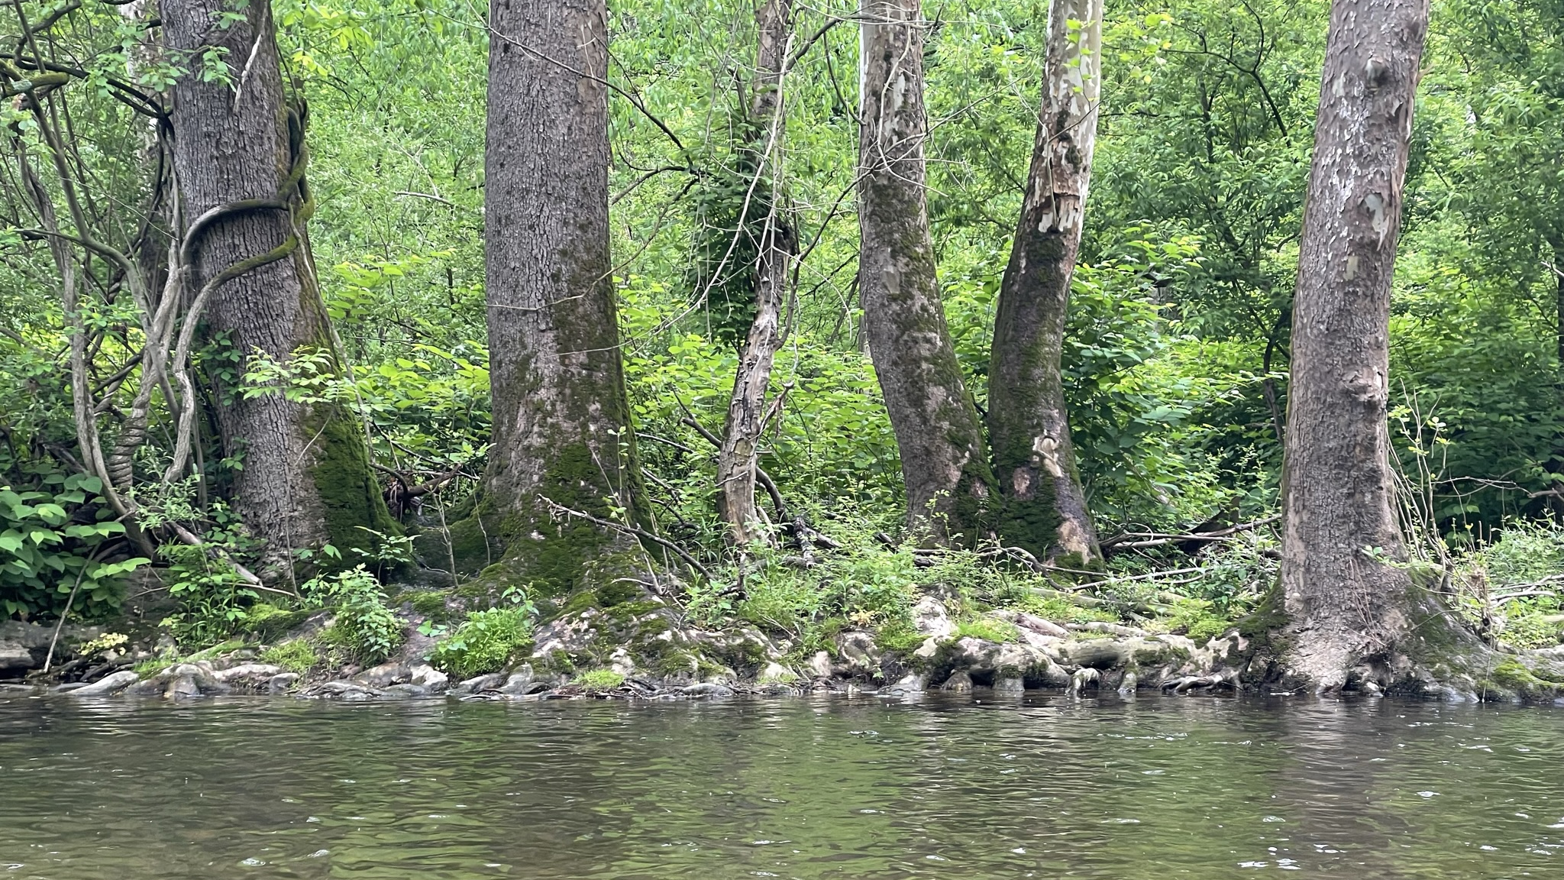
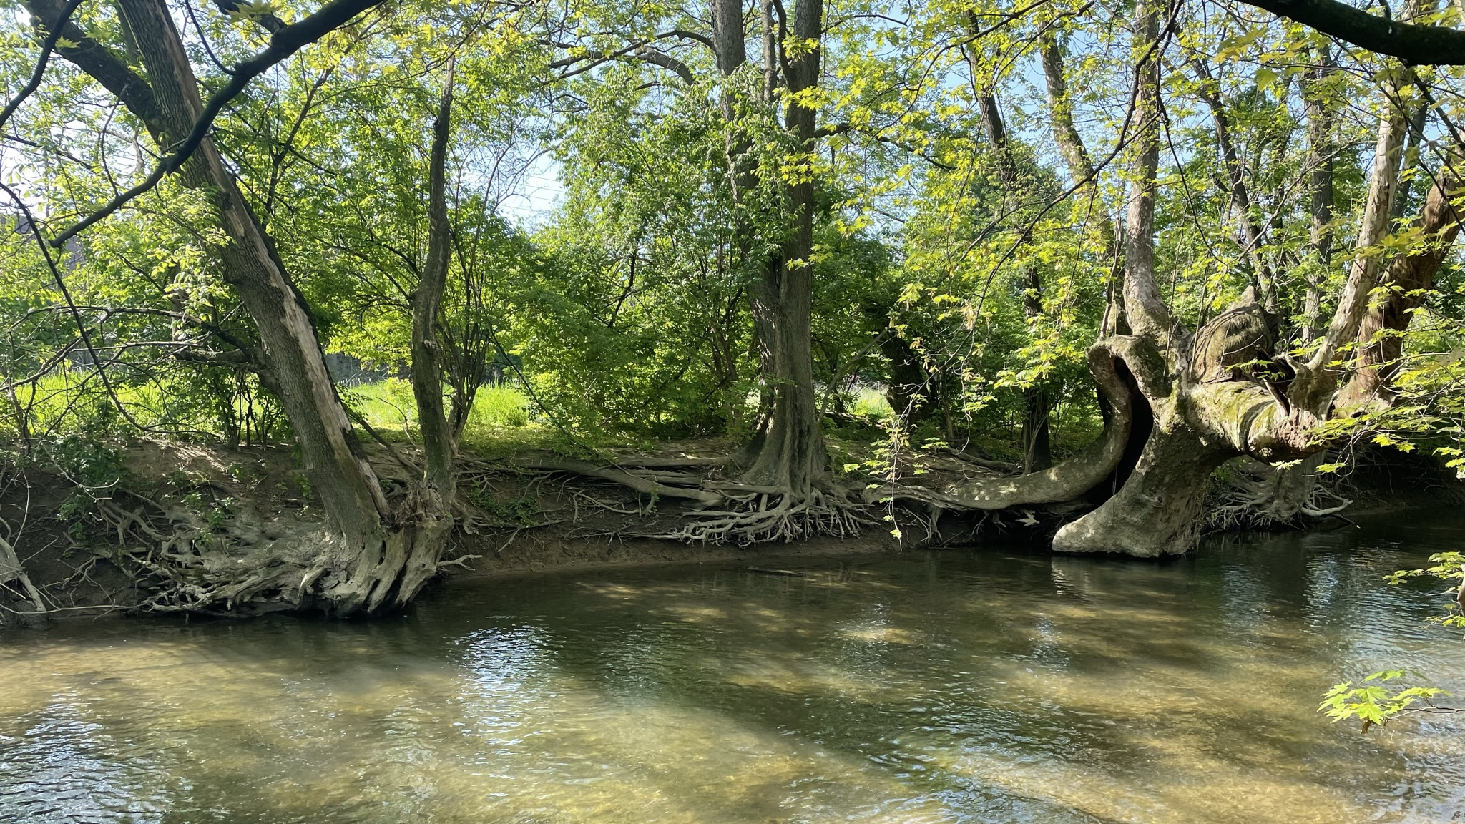
Notes:
Knowing how and when to preserve trees without compromising the stability is very important.

Slide 22
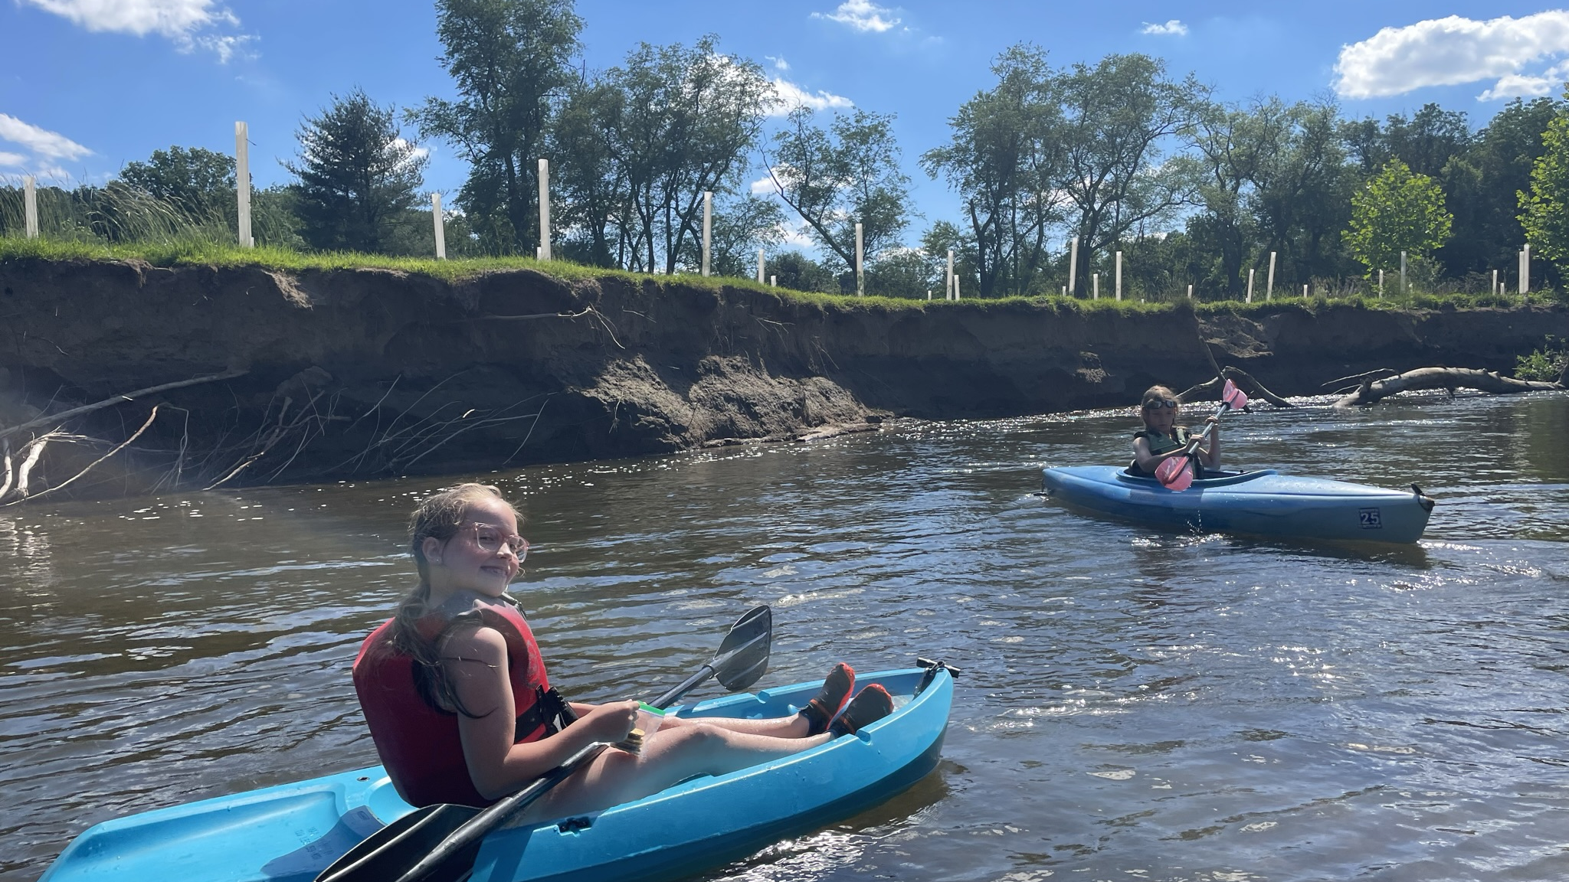
Notes:
We need to think about when riparian buffer plantings are appropriate and when they are not.

Slide 23
Misconceptions about Floodplain Restoration
Floodplain restoration projects cause warming of surface waters because the existing canopy is eliminated.
Notes:
First, eliminating the surrounding canopy is not the objective of a given floodplain restoration project.
But sometimes tree removal is necessary to create a sustainable situation. And sometimes you need to give a little to get something better.

Slide 24
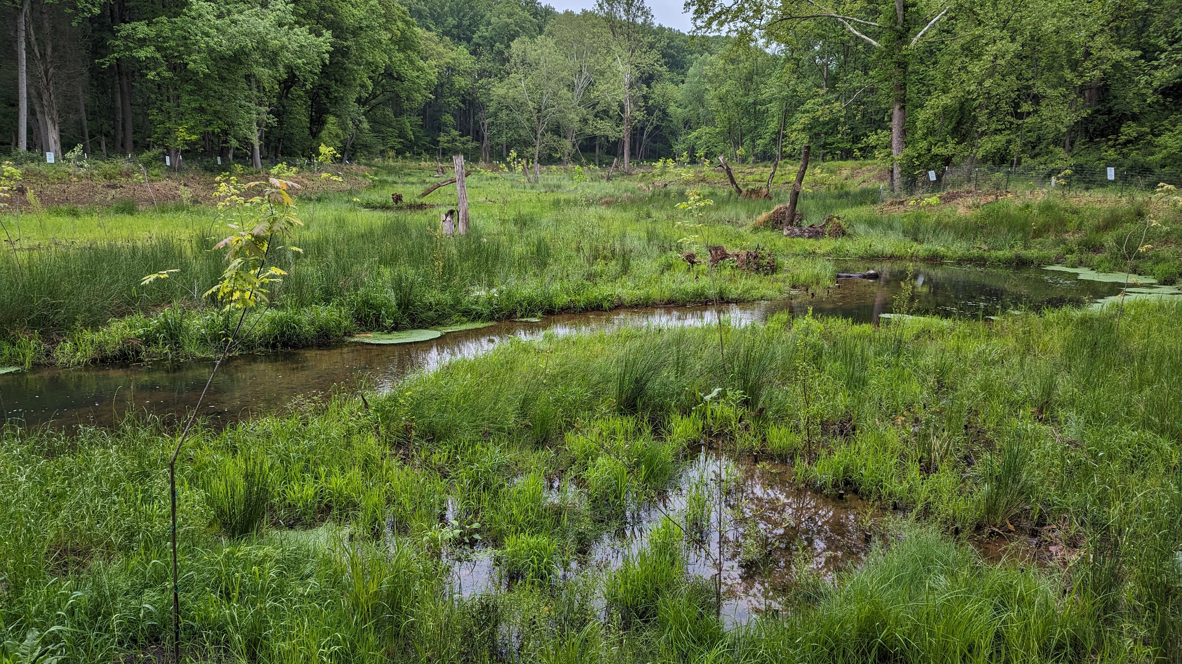
Notes:
These projects aim to create a reliable connection with the hydrology, specifically the interfacing between groundwater and surface water, or hyporheic zone, which keeps water temperatures uniformly cool often regardless of shade.
These cool temperatures, which are important aquatic habitat, remain consistent even with extreme swings in weather conditions.

Slide 25
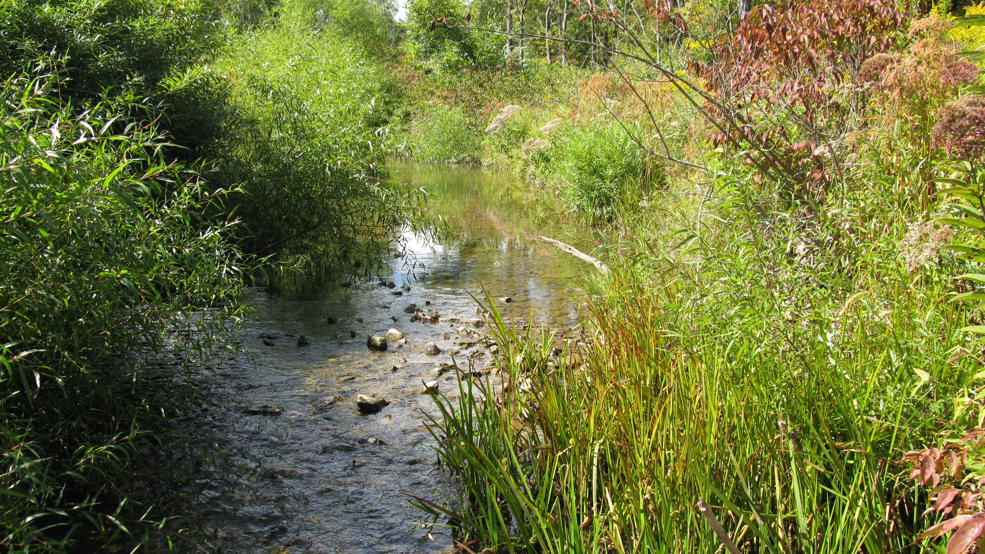
Notes:
And often, once mature, herbaceous and scrub-shrub vegetation does provide more shade and overhead cover than most people realize.

Slide 26
Misconceptions about Floodplain Restoration
Floodplain restoration is applicable to all sites and situations.

Slide 27
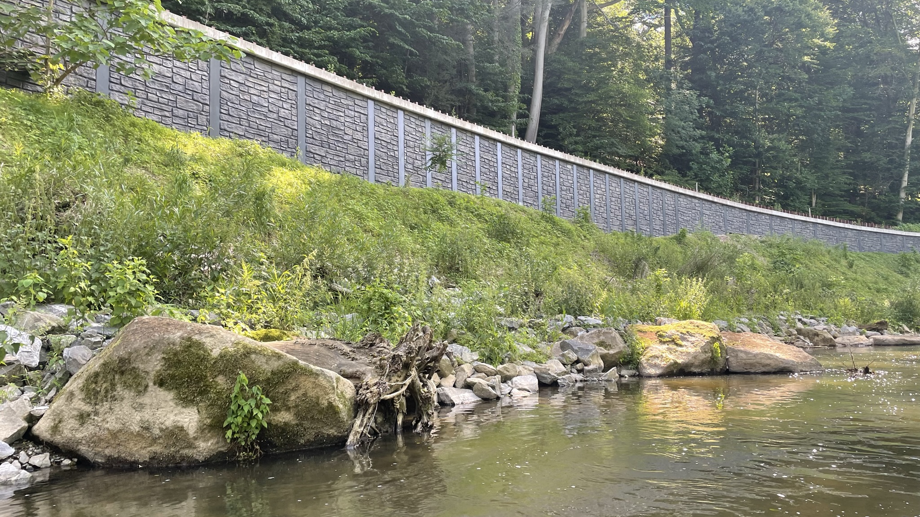
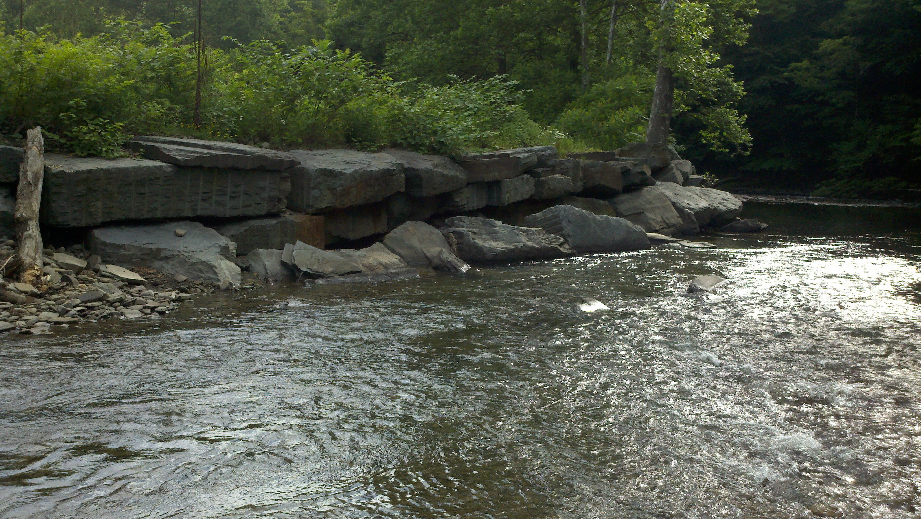
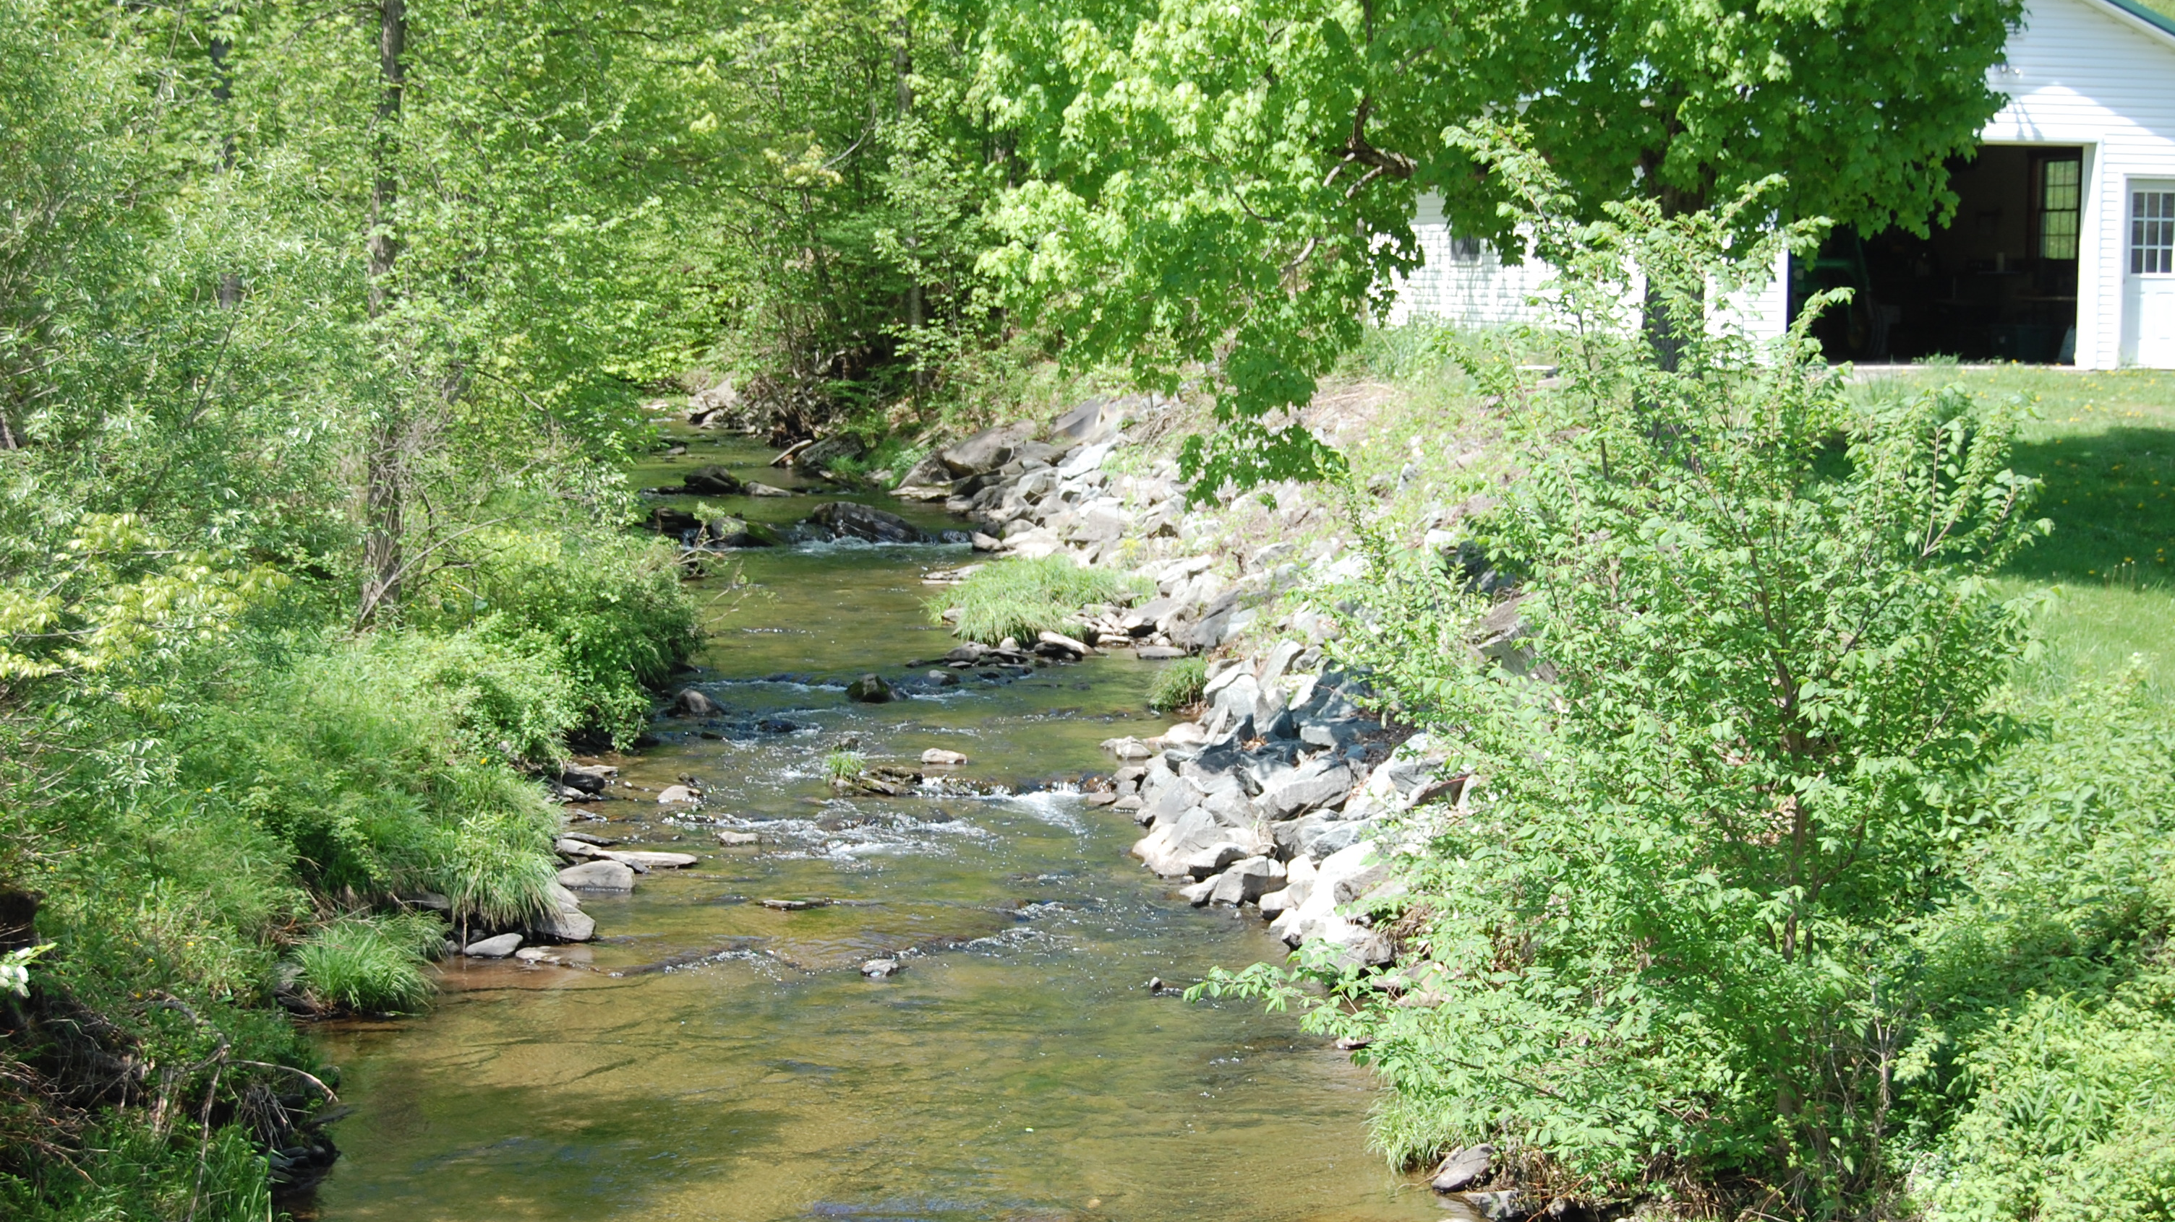
Notes:
Other stabilization and enhancement strategies are not necessarily wrong, but they are often just temporary fixes rather than a solution and will not return the level of function that was lost from the natural condition.

Slide 28
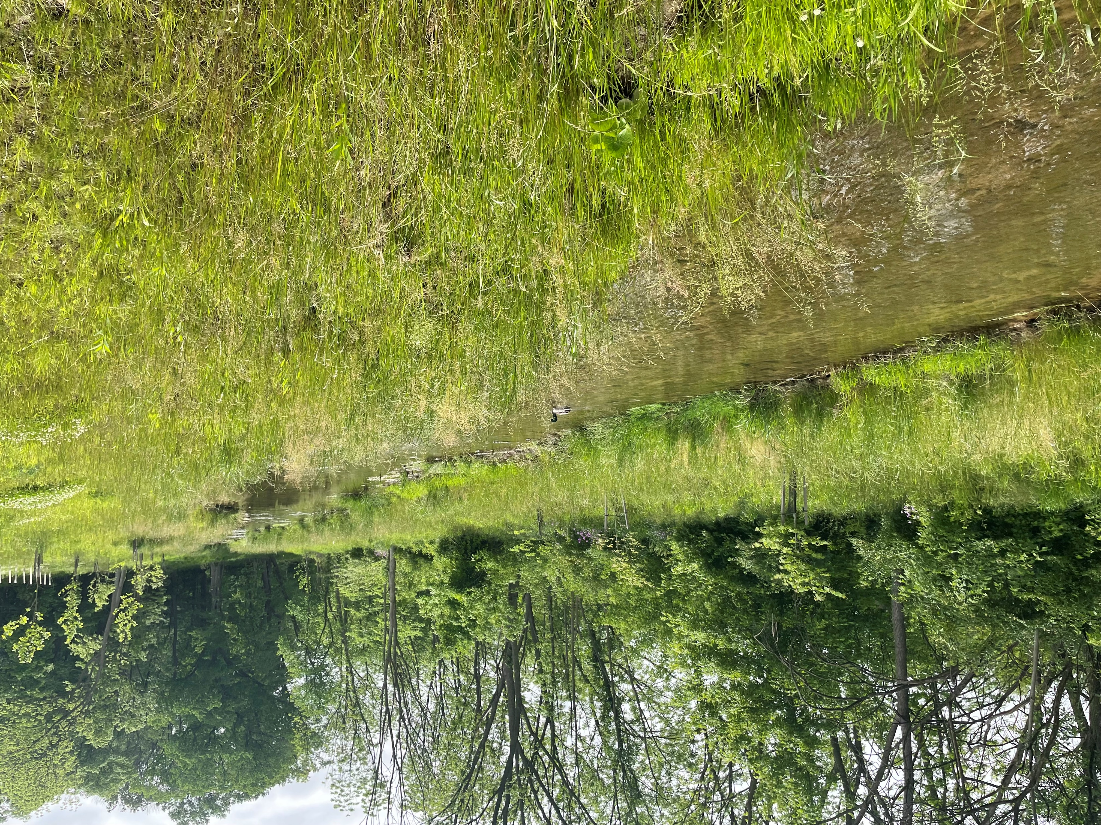
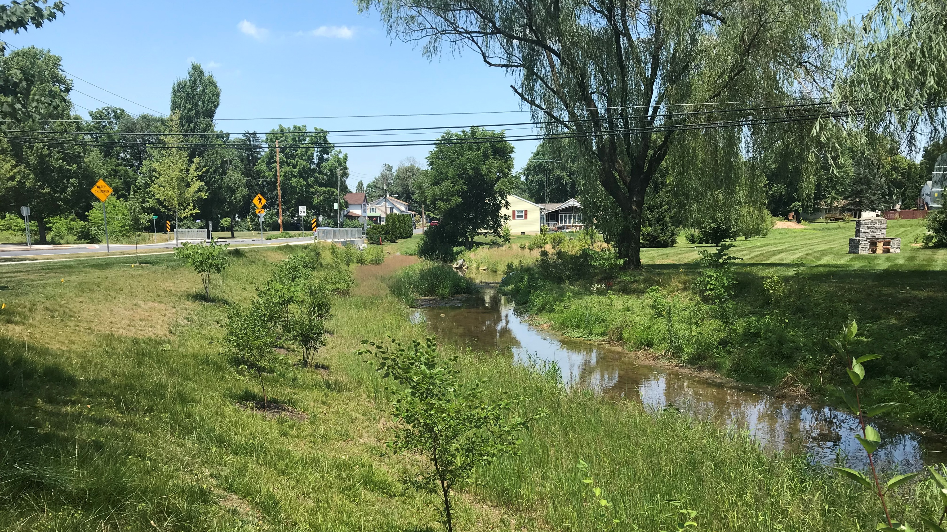
Notes:
When space is limited, we typically prefer to implement low elevation benches and bank grading within vegetation as a more natural-looking approach.

Slide 29
2D Modeling
Existing
Proposed
Notes:
Regardless of the approach, the focus of the design should include reducing shear stresses and velocities.
2D modeling can be a very powerful tool during the design process, which often involves multiple iterations of proposed grading and modeling to identify potential vulnerabilities associated with tie-ins or where a road overtops or pinch points in the valley where high shear stress is anticipated.

Slide 30
2D Modeling
Existing
Proposed
Notes:
…. and evaluate ways to protect potentially vulnerable areas.

Slide 31
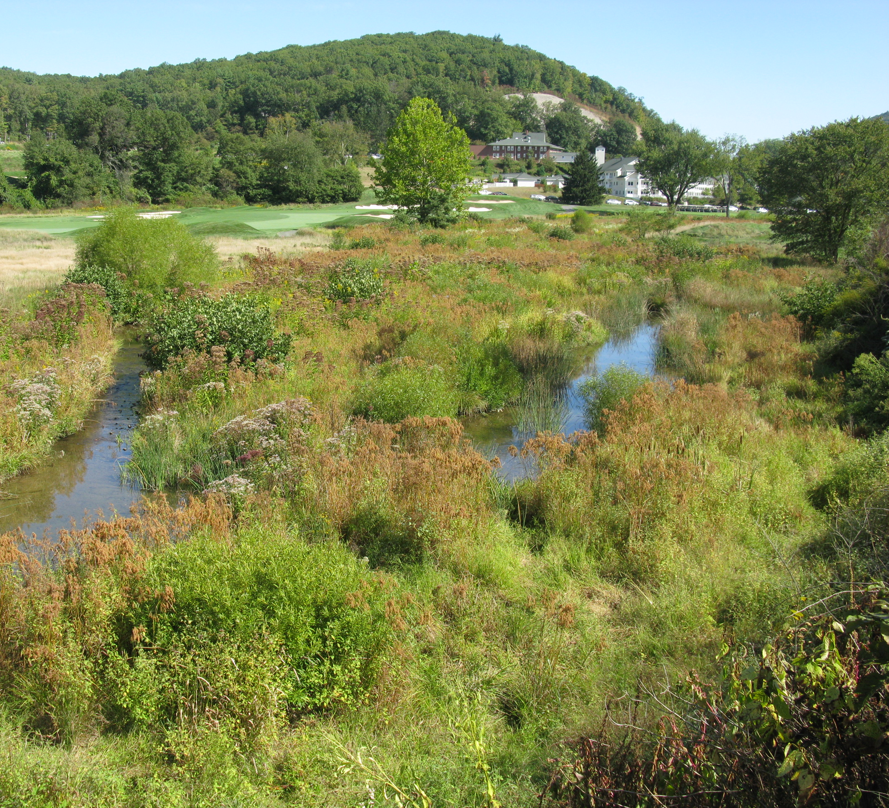
Keys to Successful Design
Historical Assessment
Identify Constraints
Subsurface Assessment
(trenches, geoprobes, tile probes)
2D Modeling
(shear stress, velocity, flow depth)
Floodplain First, then Channel
Close Attention to Tie-Ins
Reliable Grade Control
Push Boundaries
Respect the Science
Notes:
…. and always continue to evolve, learn, and be willing to fine-tune your approach to achieve success.

Slide 32
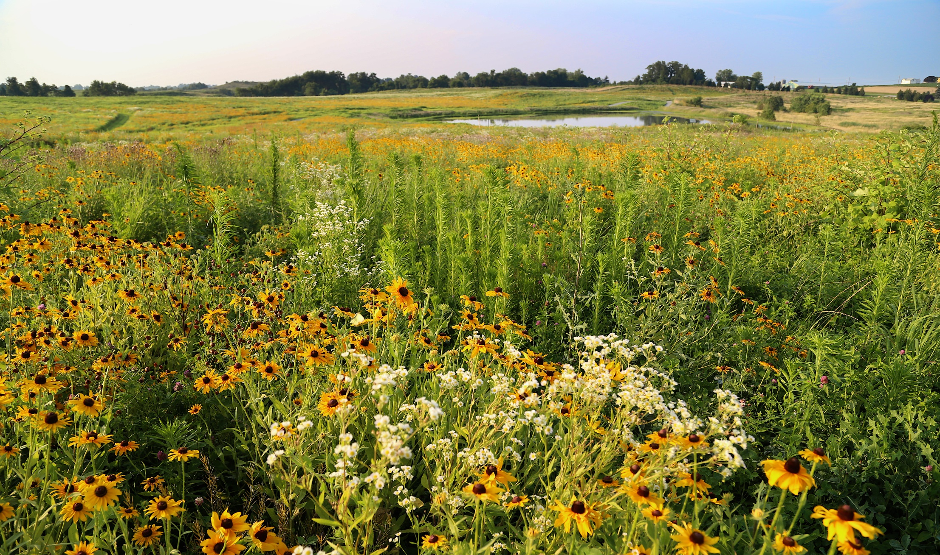
Questions?
Pioneering innovative solutions to
water resource management.
Contact:
Ben Uhler
LandStudies, Inc.
ben@landstudies.com
Design | Sustain | Restore

