Slide 1
Achieving Water Quality Endpoints: A State Perspective on the Issues and Challenges of Restoration
Jeff White
Watershed Protection, Restoration, and Planning Program
Maryland Department of the Environment
Notes:
Disclaimer: this presentation is likely going to be much different than the others.
When CWP reached out about presenting on our agency’s perspective on stream restoration, I mentioned that I probably wasn’t the best person to give this presentation
Nor am I the best person to present on the challenges of implementing upstream practices. Local jurisdictions are much better equipped to present on the physical and resource challenges of implementing upland restoration practices
What I can talk about is where we stand in achieving our collective water quality goals and endpoints given all the restoration that has occurred over the past decade, and the technical challenges of meeting those endpoints

Slide 2
What are our Water Quality Goals?
Many Possible Goals of Restoration
EJ, Climate resilience, habitat, etc.
MDE Watershed Protection, Restoration, and Planning Program Goals
CWA 303(d)
Achieve TMDL Loading Goals (Local and Downstream Bay)
Achieve WQ Criteria
Sediment, Nutrients, Bacteria, Toxics, Chlorides, Thermal
Attainment of a waterbody’s designated use
Protection of aquatic life, water contact recreation, water supply, fish consumption, shellfish harvest, etc.
Notes:
To start, I think we need to clarify and re-emphasize what our water quality goals and endpoints are
Often, restoration activities have a multitude of goals and objectives (EJ, climate resilience, habitat enhancements, etc)
However, from the perspective our our shop at MDE, who is responsible for implementing 303d of the Clean Water Act, when we talk about our goals and endpoints, we are more or less referring to the following:
Achieving TMDL loading goals (both local and bay),
Achieving water quality criteria (e.g., for sediments, nutrients, bacteria, toxics, chlorides, and temperature) and
Attainment of water waterbody designated uses (.e.g, protection of aquatic life, water contact recreation, water supply, fishing, and shellfish harvest)
That said, we are trying to integrate the other larger goals into the work we do

Slide 3
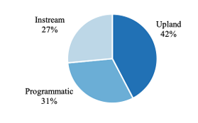
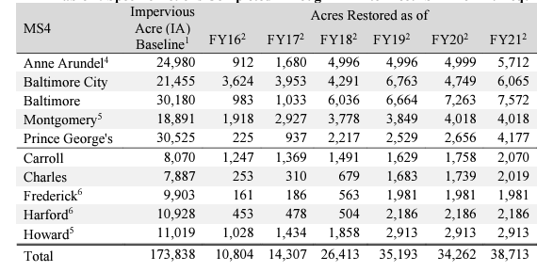
A Summary of Water Quality Restoration
Over the past decade, there has been an unprecedented amount of restoration in Maryland
WWTP Upgrades
Agricultural sector Implementation
Enhancement of Living Resources
Urban Stormwater Management
Notes:
Next, we need to step back and say what has been done in terms of water quality restoration?
In the past decade since the Chesapeake Bay TMDL was approved, there has been an unprecedented amount of restoration that has occurred in MD
Almost all of our major municipal WWTPs have been upgraded to ENR treatment or are in the process of being upgraded
Implementation in the agricultural sector
Enhancement of Living Resources, and
Urban Stormwater Restoration
Mainly via our Phase I MS4 permit but also through our Phase II Permits and even our Industrial SW Permit
I’m going to hone in on and focus on the stormwater restoration for the remainder of our presentation, since a large number of our Western Shore Local TMDLs are mostly SW driven, and I assume that is the focus of the majority of today’s audience
The following graphic and table are from our report of the Phase I MS4 Financial Assurance Plans, and one key thing it shows is that stream Restoration is only a small piece of the total restoration that is occurring
Many and variable restoration practices being implemented across these jurisdictions, and while stream restoration gets a majority of the focus, there is a lot of good work that is being done, which should also be highlighted
The table points out the incredible extent of the work that has been done too (EIAs, not hard acres, but best metric available)

Slide 4
The Impact of Restoration
TMDL Perspective
TMDL Load Accounting
Bay TMDL
319 watersheds (NPS only)
Phase I MS4 jurisdictions (SW-WLA only)
Many Phase I MS4s are starting to achieve their SW-WLAs
Many more in the next several years
WQ Criteria & Designated Use Perspective
Demonstrating achievement is more difficult
Source: MD DNR Flickr
Notes:
Now the question becomes, what impact are we seeing from all this restoration?
From a TMDL perspective, it is important to note up front that we don’t have load accounting for many TMDLs and watershed across the State
We have load accounting frameworks for the following:
The Chesapeake Bay TMDL,
Watersheds with approved a-i CWA Section 319 Plans, and (NPS only)
In our Phase I MS4 jurisdictions, but for the SW-WLA only
One take away we do have from the accounting frameworks in place though is that it is possible to meet these TMDL loading goals
For instance, we currently have many different examples of Phase I MS4 jurisdictions that are demonstrating achievement of their SW-WLA, and we expect to have many more in the next several years
So, it is possible to put enough practices in the ground to meet TMDL goals
What is more challenging is then subsequently demonstrating achievement of WQ criteria and attainment of waterbody designated uses

Slide 5
Challenges and Issues
Why aren’t we achieving WQ criteria given the amount of restoration that has been implemented?
Many challenges and questions
Sector specific attainment of loading goals
Do we simply need more time?
Are our BMPs functioning as we predicted?
Are our models off, and are greater reductions required?
Do we even have the necessary data to evaluate if we are achieving the criteria?
Does a criterion even exist?
Are our assessments flawed?
Has the work to address a particular stressor even begun?
MDE is currently working to address many of these questions
Development of new modeling tools which will be used to reassess old TMDLs
Development of new Integrated Report assessment methodologies
Development of new water quality criteria
New data collection efforts
BSID Updates and revisions
Source: MDE Flickr
Notes:
So, the question then becomes why aren’t we achieving WQ criteria given the amount of restoration that has been implemented, particularly in watersheds where we are achieving our loading goals
This answer is not easy and poses many challenges and subsequent questions
For starters, in many instances, we may only be achieving one half, or one portion of a given TMDL, e.g., maybe only the SW sector or WWTPs are meeting their goals
Or, do we simply need more time? We know there is a lag-time for nitrogen, but are there significant lag-times for other pollutants as well?
For instance, we know that there will be some period of time between reducing PCB loads to a waterbody and seeing concentrations come down in fish tissue
Are our BMPs functioning as intended or as predicted?
Are our models off?
Are greater reductions required than originally predicted?
One caveat here is that we know every model is going to be imperfect, so the best we can do is to keep improving
Do we have the necessary data to even perform the evaluation?
For instance, when it comes to our tidal nutrient assessments, we don’t even have the necessary resolution of data to perform the full evaluation.
Maybe our assessments flawed?
For instance, we have certain parameters for which we don’t have criteria, e.g., sediments, whereby we use our biological stressor identification process to identify if sediment is an impairment or not
Maybe some of the parameter linkages are off here
Or, maybe the scale of our assessments is way too large to determine if restoration has led to achievement of water quality criteria
For biology in our non-tidal waters, our assessments are performed at an 8-digit watershed scale, and this might simply be too large to determine an effect
Better yet, maybe there are flaws with out BSID itself
Maybe we’re not even evaluating certain stressors that could have a significant impact on biota
Or, maybe the work hasn’t even begun to address certain stressors
Most of our restoration to-date has focussed on nutrients, sediments, hydrology, and hydraulics
But what about the other stressors that we know have an impact on biology, such as chlorides and road salts, and that work has really just begun
The point is that there are a ton of technical questions that will not be resolved anytime in the near future, but we’re working towards figuring all of this out
For instance, we’re currently working on creating new and better modeling tools with the intention of re-assessing our old TMDLs
We’re also working on new and better assessment methodologies for our Integrated Report, which will include methodologies to perform biological assessments at a scale smaller than the 8-digit
We have pilot projects to collect the resolution of data needed to assess our tidal nutrient impairments
We are working on new water quality criteria, and we’re also initiating work to update and revise our BSID, examining our methods and potentially looking at new stressors that might be impacting biology

Slide 6
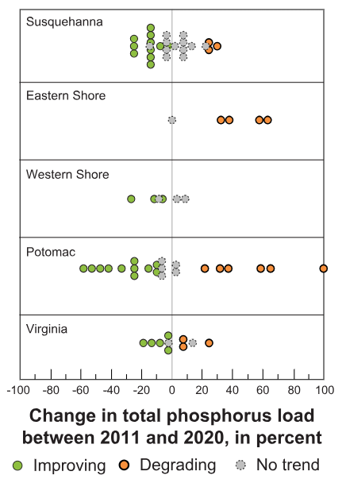
Progress
Improvement in TN, TP, and TSS concentrations/loads and other nutrient related parameters
USGS
DNR Core-Trend
MDE
Corsica River Example
Baltimore Harbor Example
MS4 Chemical Monitoring Example
Improvement in Bacteria concentrations
Baltimore Harbor Example
Delistings
Low pH and AMD Delistings
PCB Fish Tissue Delistings
Hg Fish Tissue Delistings
Many others
Notes:
While there are a ton of outstanding questions to answer, there has also been a ton of progress made to-date, which indicates that the restoration that we’ve put in the ground has had a significant pay-off
We’ve seen positive trends in a number of datasets indicating that both nutrient and sediment concentrations and loads are decreasing
We’ve also seen positive trends in nutrient related parameters, such as chl-a, as well
For instance, USGS data indicates that nutrient and sediment concentrations and loads are general decreasing in many watersheds across Maryland
This conclusion is also supported by DNR Core-Trend data, which indicates the same thing
These analyses are presented in our draft 2024 IR
MDE also has numerous studies that indicate the same and others that indicate that nutrient related parameters, such as chl-a, are also decreasing
For instance, our field staff have been collecting nutrient related data in the nontidal tributaries to the Corsica River for almost 2 decades now. The data indicates that generally nutrient and sediment concentrations and loads have decreased
We’ve also been working with UMCES to evaluate system response in the Patapsco, mainly from WWTP upgrdaes, and we’re also seeing similar progress in decreasing water column nutrient concentrations as well as chl-a concentrations, particularly in surface waters. Bottom waters don’t necessarily see the same improvement, but they seem to be more tied to Bay mainstem WQ
Lastly, we have spent a significant amount of time with the help of ICPRB looking at the MS4 data that has been collected through time, and we’ve found that when data quality and the data record are sufficient, and in instances where watershed noise is reduced, we can see clear signals in improvement, especially in TSS, metals, and flow
Lastly, we’ve seen significant improvement in bacteria concentrations in the Baltimore harbor over time due to work the City has done via its consent decree to eliminate SSOs and its pollution source investigations
We’ve had a ton of success with addressing AMD sources in western MD and correcting low pH problems
And we have also seen a number of PCB and Hg fish tissue delistings, as concentrations of these pollutants continue to decrease due to both reduced air emissions and natural attenuation
There have been many other delistings through time, but I only highlight those above, since we know they are due to “fixes” or restoration that was performed. The others are sometimes very hard to identify if they are due to fixes or simply new data or changes in methodologies

Slide 7
Conclusions
Watershed Restoration is complex
An incredible amount of restoration has been implemented to-date
This restoration includes a wide variety of structural, upland, in-stream, and annual practices
In many cases, this restoration has resulted in the achievement of our TMDL loading goals
However, water quality monitoring data does not demonstrate that criteria are being achieved
There are many complex reasons why restoration has not yet resulted in the attainment of water quality criteria
This should not negate the importance and relevance of the work that has been done to-date, and significant progress has already been made

Slide 8
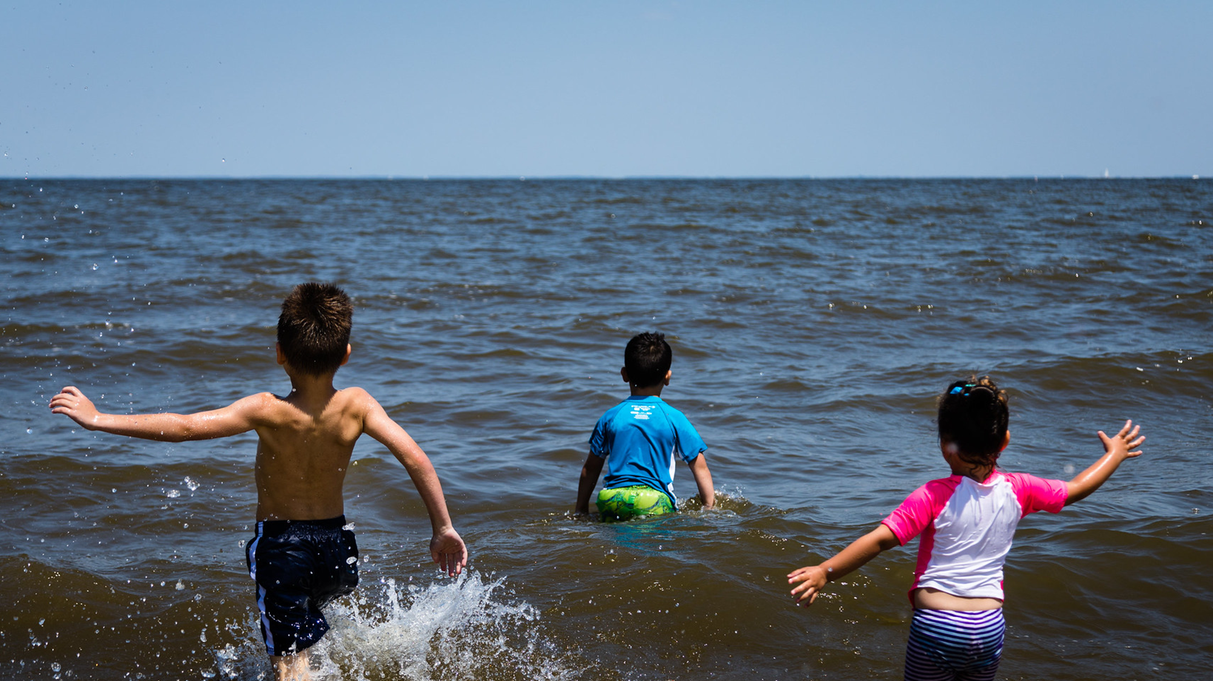
Thank you!!
Notes:
(back to moderator)

